Slide 1

Team Details
  Team name: ASM FinTech Developer
  Team leader name: Abhinav Mukwane
  Problem Statement: Financial Health Score

Slide 2
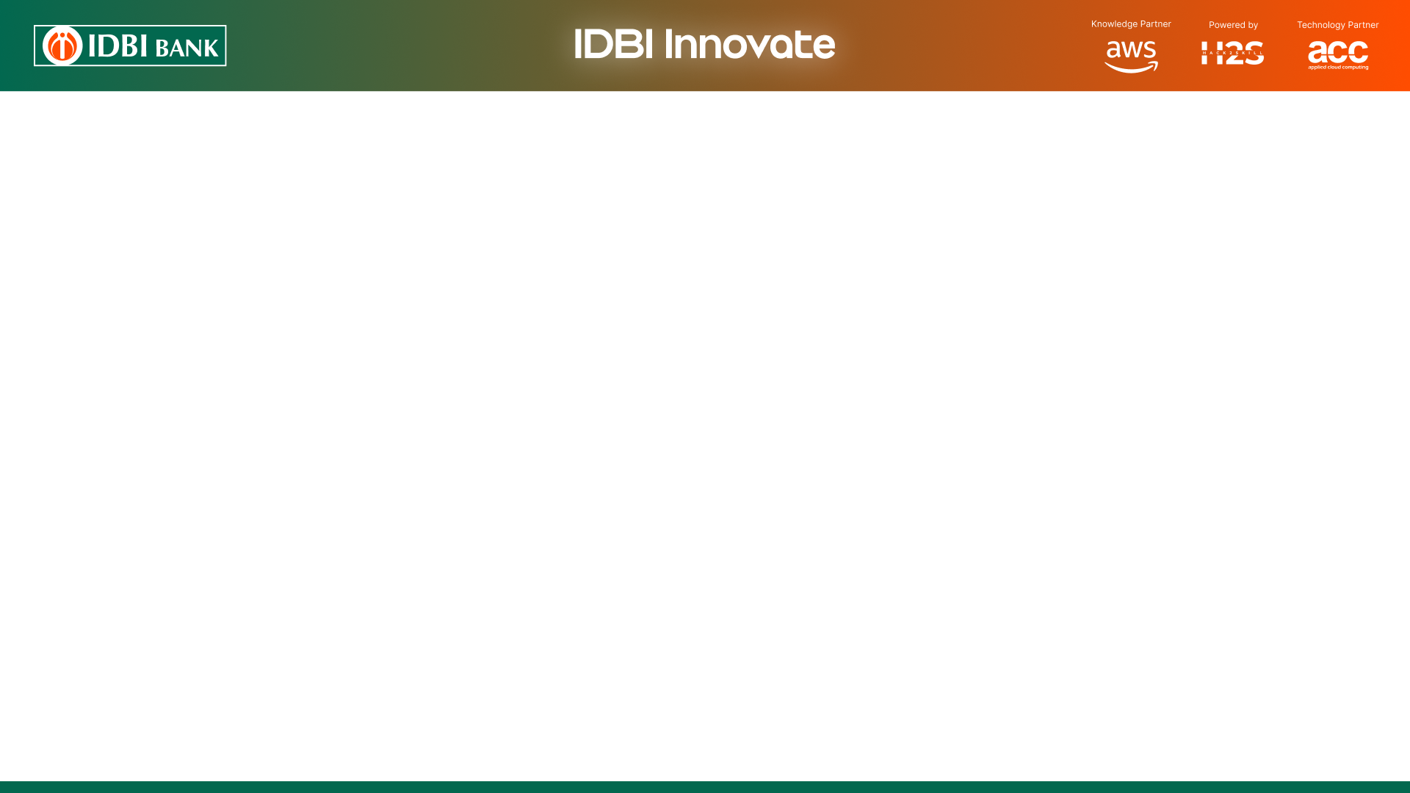
Brief about the idea
India has 6.4 crore MSMEs contributing ~30% of GDP, yet 80%+ have no formal credit. New-to-Credit (NTC) and New-to-Bank (NTB) enterprises are rejected for missing paperwork — not for being bad borrowers.
FinRiskLensAI — AI-powered MSME Financial Health Score platform (Top-5 Finalist build)
One consent, five sources: Udyam, GST (7 return types), ITR, bank statements via Account Aggregator, and MCA company & director records
One score, six pillars: Financial Health Score 0–1000 from a rules engine + ML.NET LightGBM — every score comes with plain-language reasons
Financial Health Card: score gauge, 6-pillar radar, strengths & risks, lending eligibility (working capital + term loan) and the right product (CGTMSE / MUDRA / standard)
NEW — Score History: every analysis is saved, so the bank sees the trend, not just today’s number
NEW — Bank Portal (Customer 360): one screen per MSME for the credit officer — score, GST, bank, ITR, MCA and directors
Integrity check: GST, ITR and bank credits are cross-checked; mismatches are flagged for officer review, not silently scored
Built for Bharat: 7 Indian languages (Bhashini), AI assistant, printable & emailable Financial Report; score in seconds; API-ready for LOS / ULI / OCEN / ONDC

Slide 3
Opportunities
How is it different from existing solutions?
Bureau scores (CIBIL / Experian) need credit history — we score NTC / NTB MSMEs with none, from their own digital footprint
Five data sources in one consent flow — Udyam, GST, ITR, bank (AA) and MCA — instead of a single-source view
Score + score history + bank portal: a working system a credit officer can use today, not just a number
Cross-source check (GST vs ITR vs bank credits) as a built-in integrity signal — no existing tool does this
How does it solve the problem?
Ends the ‘no documents, no credit’ cycle — the MSME’s existing filings and statements are the documents
2–3 weeks of manual appraisal becomes an automated assessment in seconds
Every score carries dimension-level reasons — the officer sees why, not just what
Neutral baseline for first-time borrowers — missing history is not treated as bad history
USP of the proposed solution
Six-pillar score (Revenue, Cash Flow, Transactions, Compliance, Stability, Debt) — a far richer picture than any single metric
Built on India’s DPI stack — consent-based, no proprietary data, aligned with the DPDP Act 2023
Product recommender maps the score band to CGTMSE / MUDRA / standard loans — more approvals, safely
Score history gives IDBI post-disbursement monitoring — origination and monitoring from one platform

Slide 4
List of features offered by the solution
Data Aggregation — 5 sources, one consent
Udyam registry · GST (GSTR-1 / 2A / 2B / 3B, HSN, credit notes, ITC) · ITR (ITR-4 / 5 / 6) · Account Aggregator bank statements (Finvu) · MCA company, charges & DIN-verified directors
GST ↔ ITR ↔ bank-credit reconciliation with a cross-source anomaly flag for officer review
AI / ML Scoring Engine
Six weighted pillars, 0–1000: Revenue Vitality 25% · Cash Flow Health 20% · Transaction Trust 15% · Compliance 15% · Business Stability 15% · Debt Serviceability 10%
Rules engine + ML.NET LightGBM calibration (0.6 / 0.4), SSA cash-flow trend, PFI explanations, neutral baseline when a source is missing
Financial Health Card & Report
Score gauge, 6-pillar radar, top strengths & risks, lending eligibility — working-capital limit (Nayak) + term-loan capacity, 14-ratio appraisal
Product recommendation (CGTMSE / MUDRA / standard), Score History trend, printable Financial Report, email delivery
Bank Portal — Customer 360 (new for the Finals)
Portfolio list with scores & bands, bank dashboard, per-MSME tabs: Score, GST, Bank (AA deep analysis), ITR, MCA, Directors
Hand-off to the lender (new for the Finals)
Raise a scored MSME as a loan case — IDBI LOS (appraisal case) · ULI (OCEN 4.0 derived data packet) · ONDC (beckn FIS12); the officer previews the exact payload before confirming
Append-only push audit with score, band and eligibility frozen at the moment the case was raised; pointing a channel at a live endpoint is configuration, not code
Security & Language
Email-OTP login, CSP security headers, source-IP fraud audit; 7 Indian languages via Bhashini; Groq AI assistant

Slide 5
What’s new since Round 1 — built for the Finals
Score History & Trend
• Every analysis is saved (append-only), never overwritten
• Trend chart on the Health Card and in the bank portal
• The base for post-disbursement early warning
Bank Portal · Customer 360
• Portfolio list with scores & bands, bank dashboard
• Per-MSME tabs: Score, GST, Bank, ITR, MCA
• Director drill-down with DIN verification
Loan case → LOS · ULI · ONDC
• Raise a scored MSME as a case from Customer 360
• Preview the exact payload, then confirm — never one click
• A live endpoint is configuration, not a code change
MCA + DIN — 5th data source
• Company status, capital, charges & AGM compliance
• Directors verified against DIN with individual PAN
• Follows entity type — shown only for companies
ITR now inside the score
• Filing timeliness, e-verification, tax paid ratio
• 44AB audit and tax-demand signals
• GST ↔ ITR turnover reconciliation
Lending, Report & Access
• Working-capital limit (Nayak) + term-loan capacity
• 14-ratio appraisal, printable report, email delivery
• 5 seeded demo MSMEs · 7 languages · IDBI palette

Slide 6
Process flow diagram or Use-case diagram
1 · Onboard & log in
2 · Collect data (one button each)
3 · Score
4 · Use the score
1. Enter Udyam number
Udyam registry lookup fetches the enterprise profile
4a. GST
12 months × 7 return files — GSTR-1, 2A, 2B, 3B, HSN, credit notes
5. Analyze
Five extractors read every file; a missing source redistributes its weight (neutral baseline)
8. Financial Health Card
Gauge, 6-pillar radar, strengths & risks, products, Score History
2. Review & consent
Owner confirms details, email + mobile, gives consent and registers (mobile seeded in the Finvu SimBanks sandbox)
4b. Bank statements (AA)
Finvu consent → owner approves → FI fetch of the statement
9. Financial Report
Printable appraisal — print or email
6. Rules 0.6 + LightGBM 0.4
Six dimensions · 0–1000 · band · PFI reasons · GST-ITR-bank anomaly · lending eligibility & products
4c. ITR
Filing, income, tax paid, audit
10. Bank Portal
Bank login → customer list → Customer 360: Score, GST, AA, ITR, MCA, Directors
3. Email OTP → dashboard
OTP verified, session starts, routed by status
7. Persist
result.json → Blob · score summary → SQL · score history appended → SQL
4d. MCA + DIN
Companies only — status, charges, directors
11. Raise the loan case
Push to LOS · ULI (OCEN 4.0) · ONDC (beckn) — preview the payload, then confirm
Existing MSME
/Auth/CustLogin → email → OTP → dashboard
Stored per MSME
each source saved as JSON in the <UAN>/ blob folder; fetched sources are locked
Re-analyze
any time — re-runs 5–7 from the stored files; every run adds a history point
Inbound API — planned
JWT + OpenAPI so the LOS pulls a score from us; the outbound push above is built

Slide 7
Architecture diagram of the proposed solution
Data sources — one consent, pulled per MSME into its own blob folder
Udyam
identity, NIC, vintage
GST
7 return types · 12 months
ITR
ITR-4 / 5 / 6 · filing & tax
Account Aggregator
Finvu · bank statements
MCA + DIN
company, charges, directors
EPFO
planned — slot ready
FinRiskLensAI — ASP.NET Core 8 MVC · one deployable (Web + Services + ML.NET, no separate ML service)
Web — presentation
Customer dashboard · Financial Health Card · Bank Portal (Customer 360) · Score History · Financial Report · loan-case push · Bhashini (7 languages)
Services — application
Onboarding & OTP · Udyam / GST / ITR / AA / MCA connectors · blob analysis · score history · loan-case builders (LOS / ULI / ONDC) · Groq assistant
ML.NET scoring engine
Rules engine 0.6 + LightGBM 0.4 · SSA cash-flow trend · RandomizedPCA GST-ITR-bank anomaly · PFI reasons per dimension — in-process, no Python
Data — infrastructure
EF Core 8 + SQL Server · repositories via convention scanning (Autofac)
Core — domain
Entities, view models, interfaces · no infrastructure dependencies
SQL Server
profiles · OTP & consent · score summary · score history + push audit (append-only)
Azure Blob Storage
one folder per MSME · raw source JSON (up to 93 files) + result.json
Outputs
Financial Health Card & Report
on screen · print · email
Bank Portal · Customer 360
credit-officer view per MSME
Loan case → LOS · ULI · ONDC
preview the payload, then confirm · endpoint is config, not code
Inbound score API
planned — JWT + OpenAPI so the LOS pulls from us

Slide 8
Technologies to be used in the solution
Backend — Orchestration & API
ASP.NET Core 8 MVC (C#) — connectors for Udyam, GST, ITR, Account Aggregator (Finvu), MCA / DIN; outbound loan-case push to LOS / ULI / ONDC
ML.NET in-process — scoring, feature extraction and explanations in the same deployable; no separate ML service
Autofac DI with convention scanning · Serilog structured logging · CSP security headers · DataProtection keys persisted
AI / ML Stack
ML.NET LightGBM calibration — final score = 0.6 rules engine + 0.4 ML model, trained on 3,000 MSME profiles
ML.NET SSA time-series — 12-month cash-flow trend · RandomizedPCA — GST vs ITR vs bank anomaly detection
Permutation Feature Importance — per-dimension, audit-ready reasons · Groq LLM — AI assistant for questions on the score
Data & Storage
SQL Server + EF Core 8 — MSME profiles, OTP & consent, score summary, append-only score history and loan-case push audit; SQL-backed sessions
Azure Blob Storage — one folder per MSME: raw source JSON (up to 93 files) + result.json
Infrastructure & DevOps
Single deployable web app (modern monolith) — IIS / Azure App Service / AWS; GitHub source control
Planned: inbound JWT + OpenAPI spec for LOS score pull; Azure API Management as the ULI / OCEN gateway

Slide 9
Technologies to be used in the solution
Frontend
ASP.NET Core MVC + Razor views, Bootstrap 5 — server-rendered, responsive; two themes including IDBI’s official palette
Chart.js — score gauge, 6-pillar radar, score-history trend, cash-flow charts · ApexCharts — GST analysis; charts follow the theme switch
Bhashini website-translation plugin — English + Hindi, Marathi, Tamil, Gujarati, Konkani, Sanskrit
DPI & Data Integrations
Account Aggregator (Finvu sandbox, SimBanks FIP) · GST System API · Udyam Registry · ITR · MCA 21 (company, charges, DIN)
Outbound loan case built — IDBI LOS · ULI (OCEN 4.0) · ONDC (beckn FIS12) · inbound DSP score API and EPFO — planned
Security
Email-OTP customer login and separate bank-admin login, SQL session cache, CSP headers, source-IP fraud / VPN / Tor audit with geolocation

Slide 10
Estimated implementation cost (optional)
₹ 22 L
One-time setup (build + security)
₹ 31 L / yr.
Recurring (cloud + data + support)
~ ₹ 1.15 Cr
3-year total cost of ownership
Cost breakdown - centralized cloud deployment serving all IDBI branches pan-India
Cost head | Type | Estimate (INR)
Development - 3-member team, ~6-month build | One-time | ₹ 18 L
Security testing & RBI / DPDP compliance audit | One-time | ₹ 4 L
Cloud & servers - Azure App Service, SQL, Blob, APIM | Annual | ₹ 12 L
Data & API usage - AA (Finvu), GST, ITR | Annual | ₹ 10 L
Maintenance, support & ML model retraining | Annual | ₹ 9 L

Slide 11
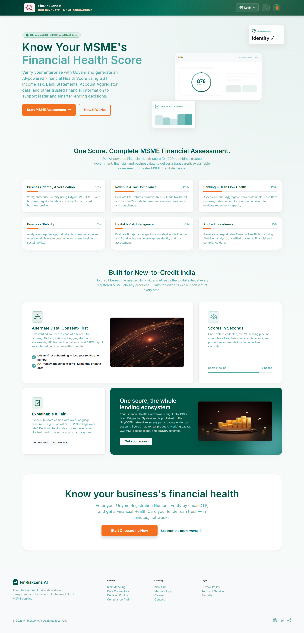
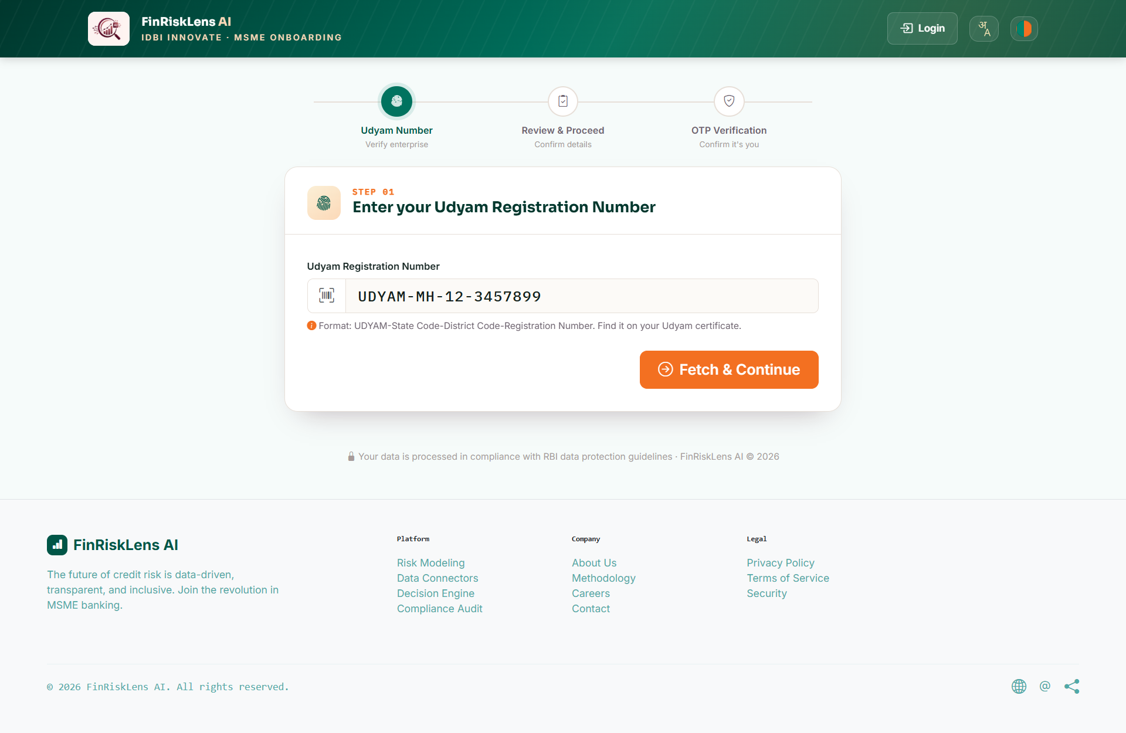
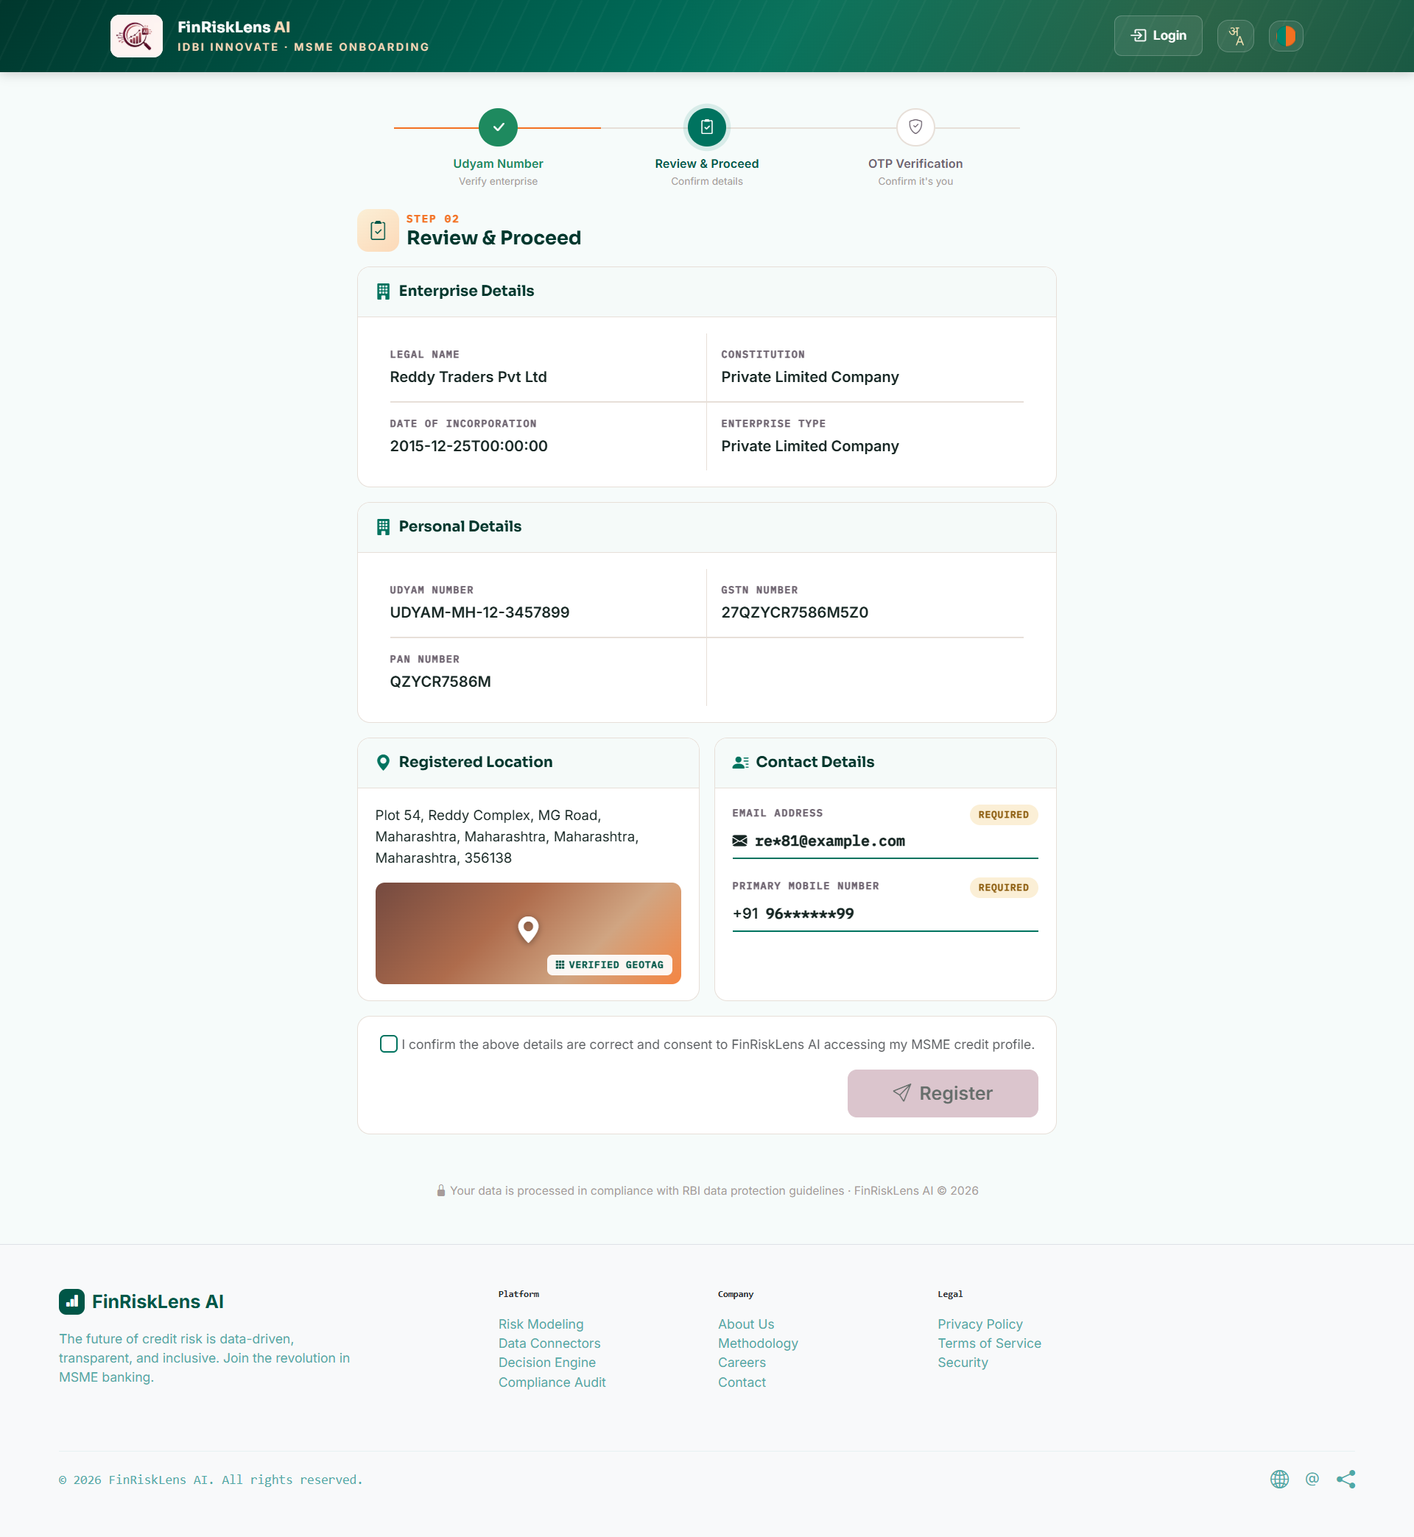
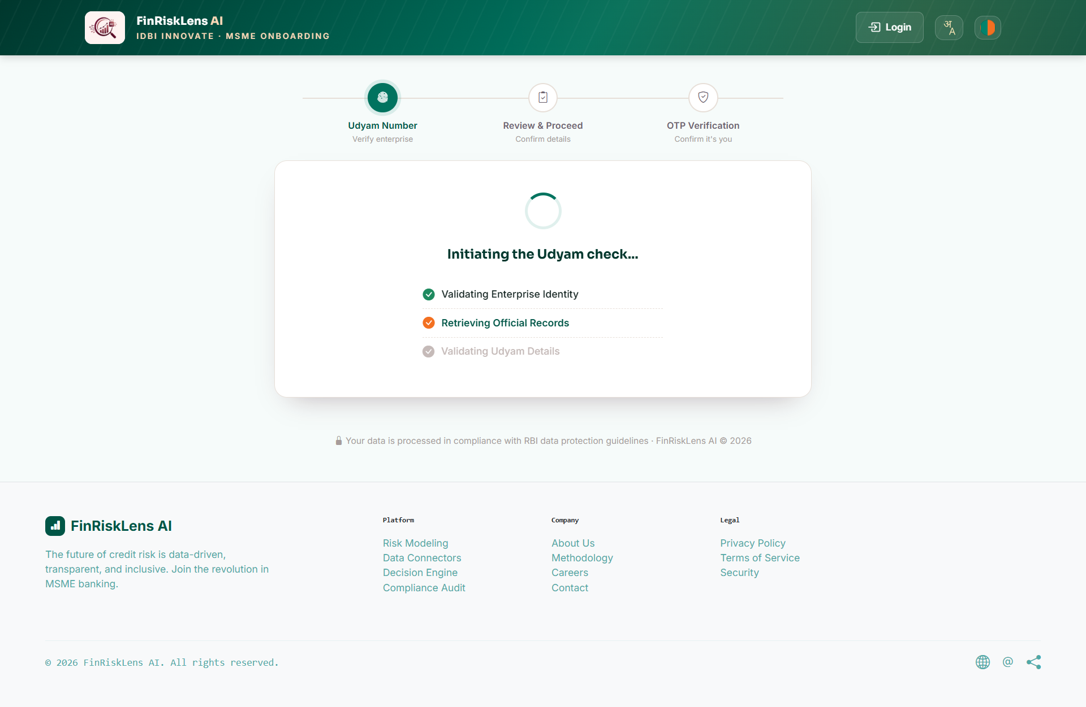
Snapshots of the prototype

Slide 12
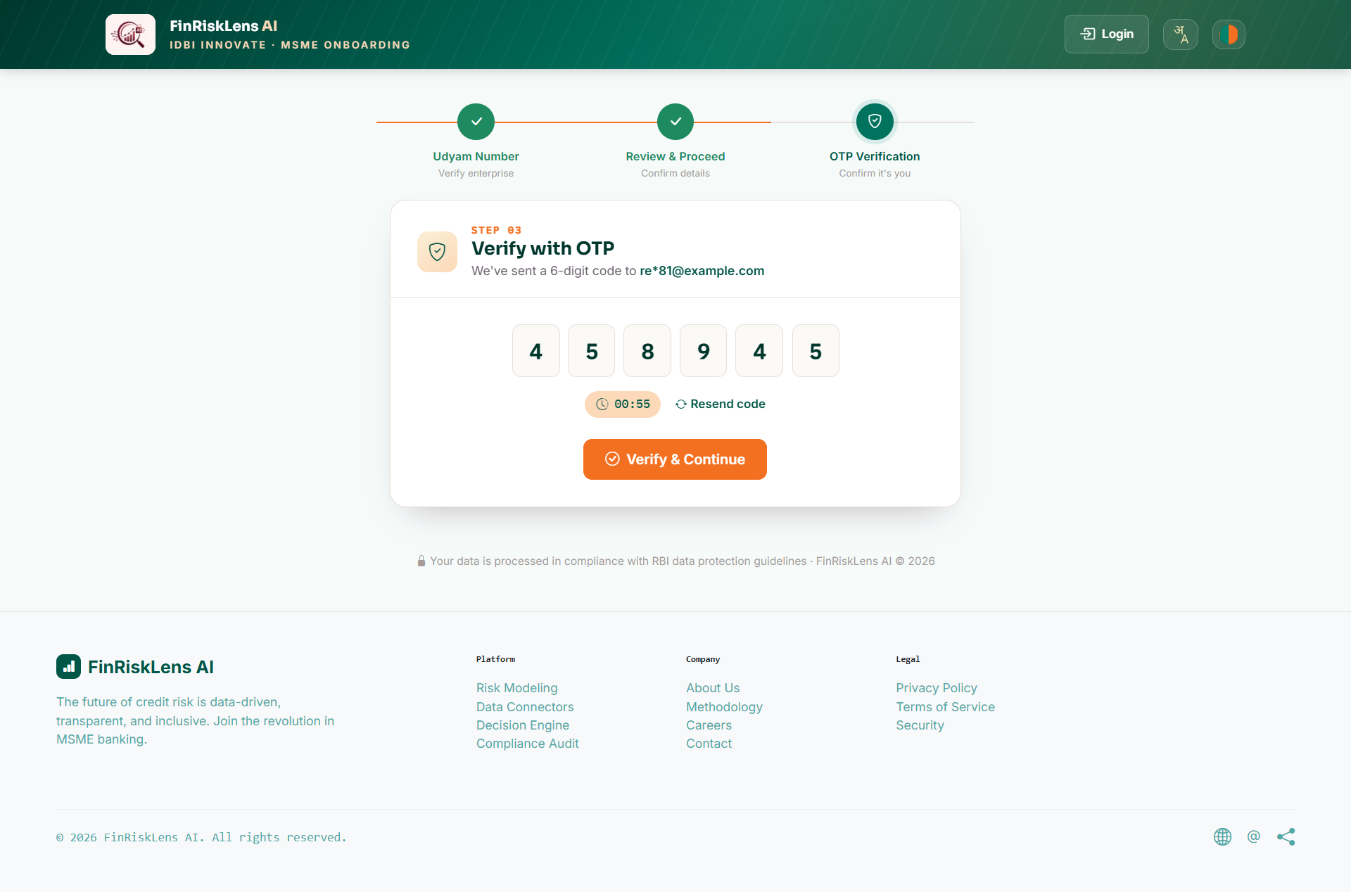
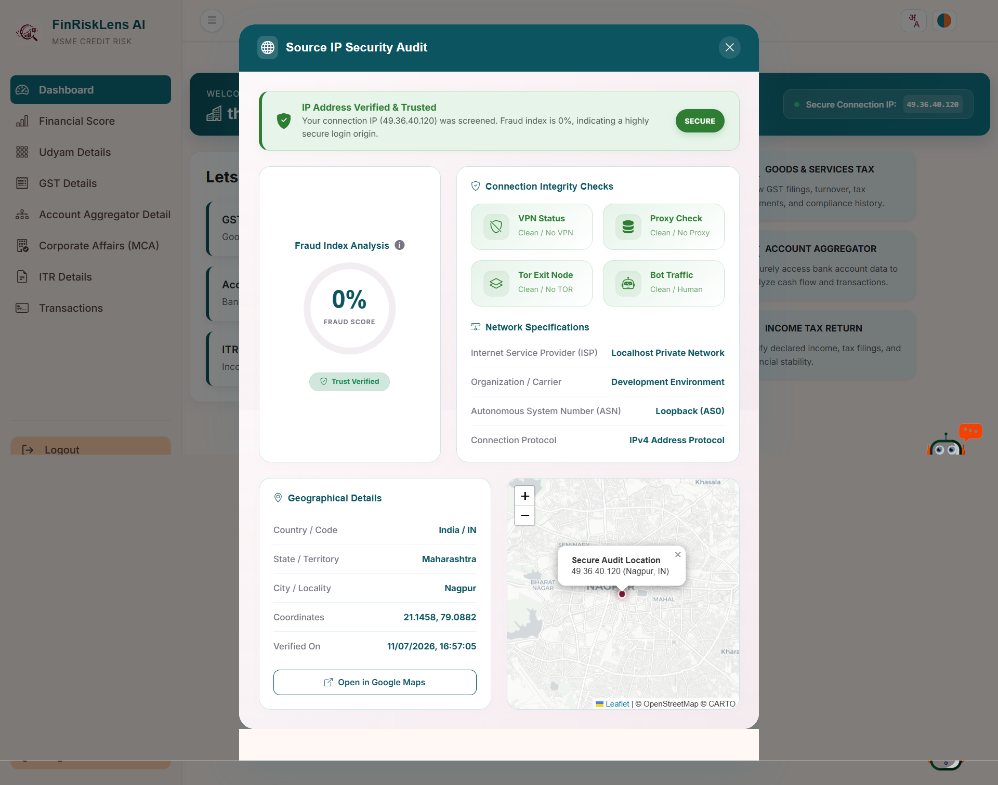
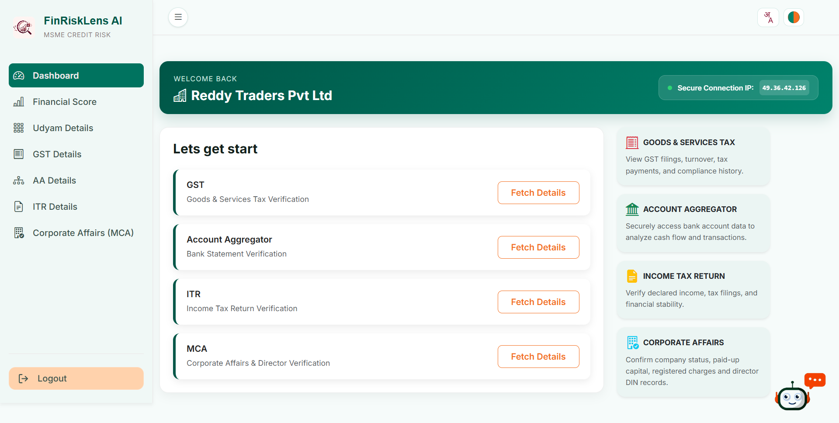
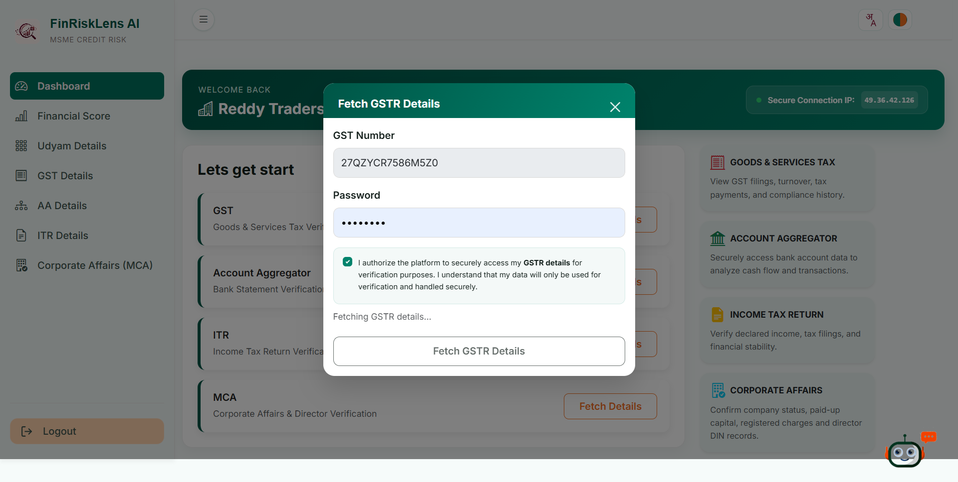
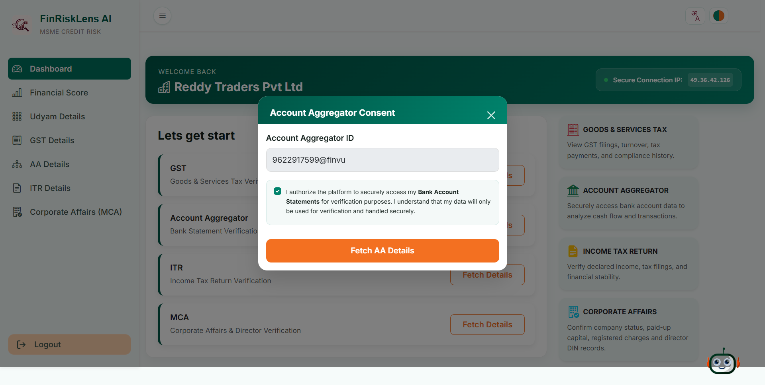
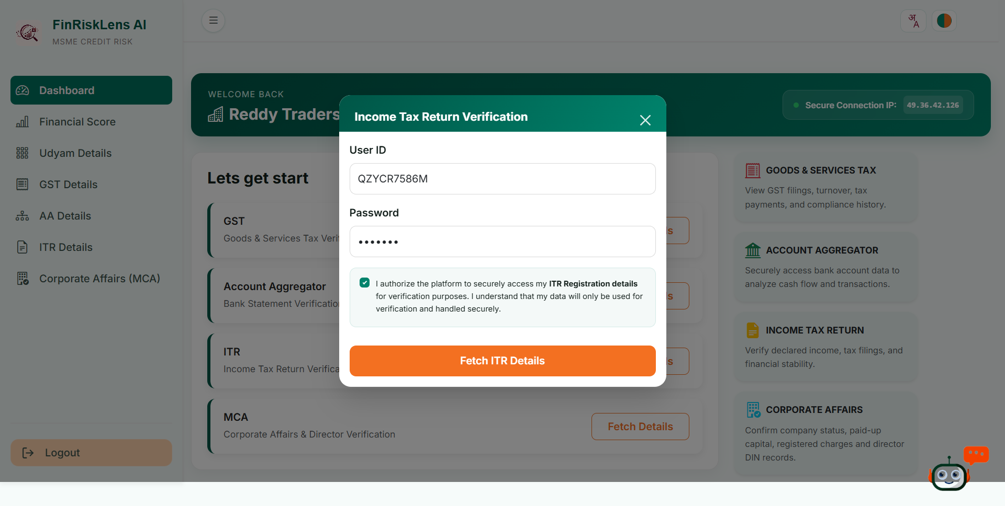
Snapshots of the prototype

Slide 13
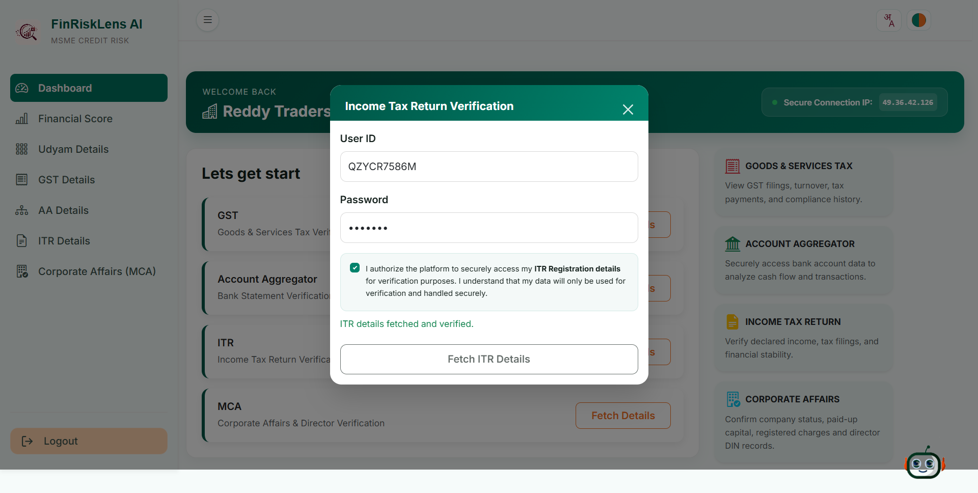
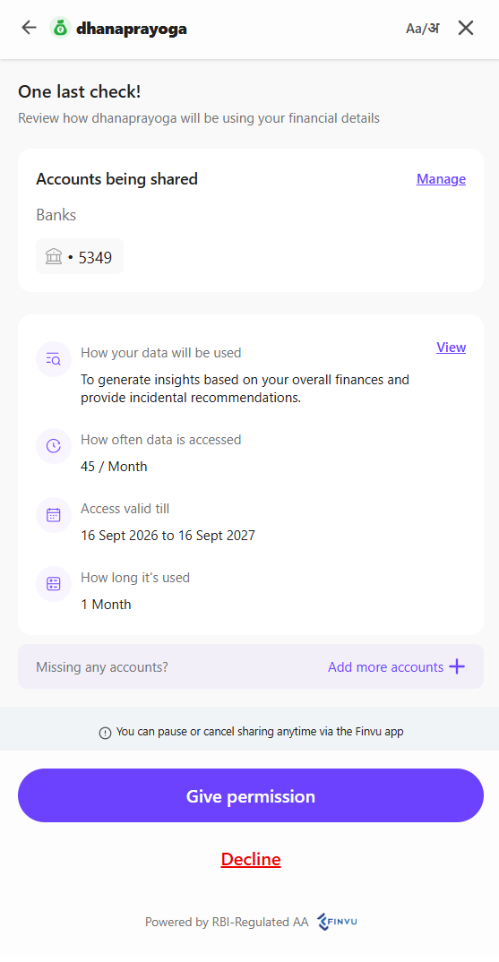
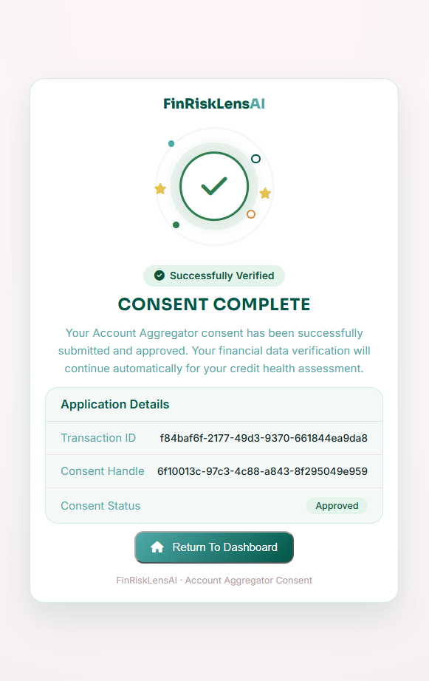
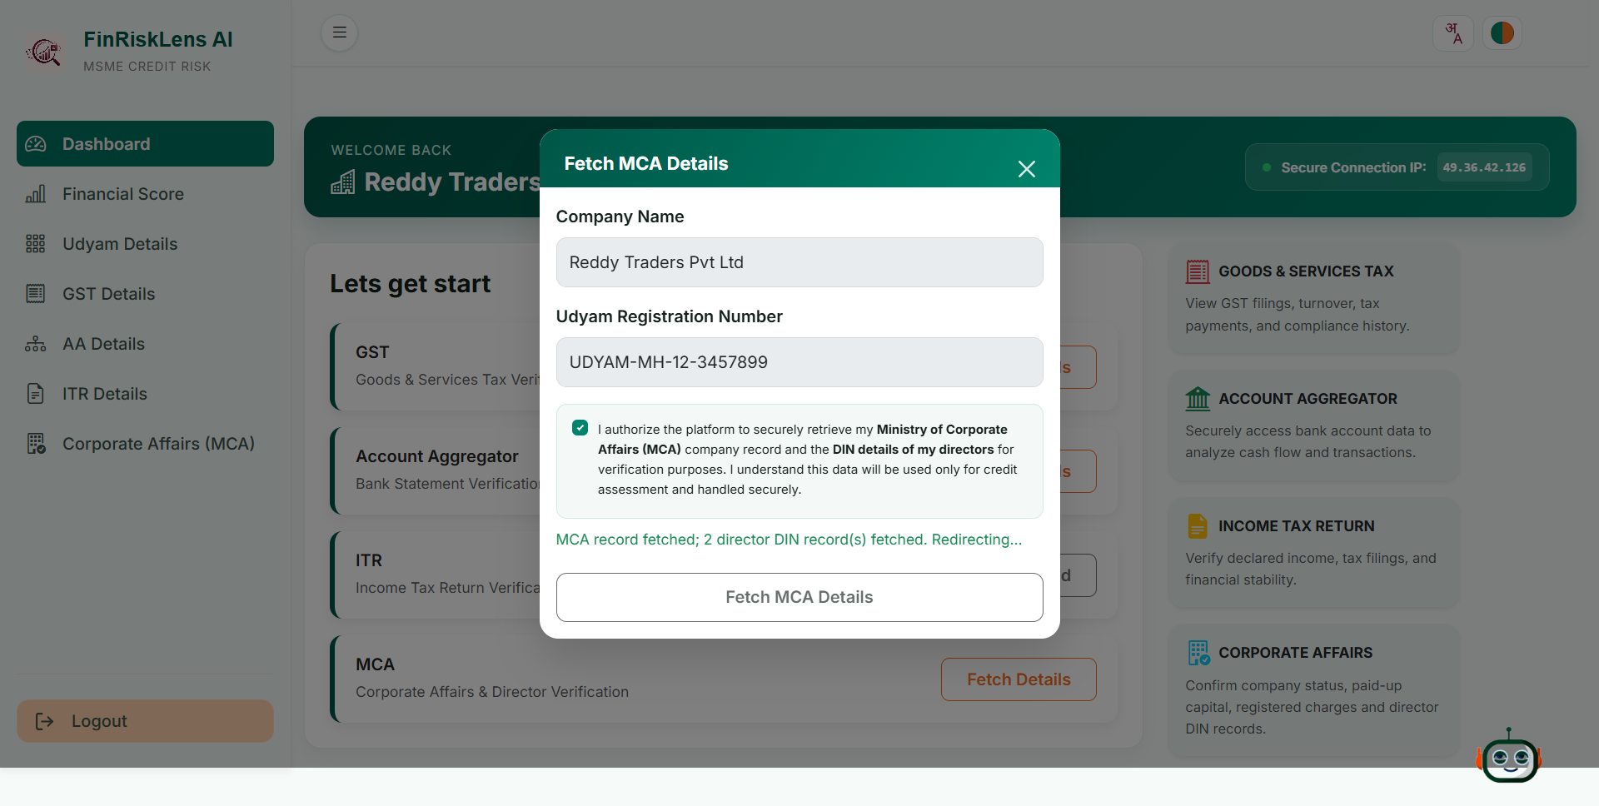
Snapshots of the prototype

Slide 14
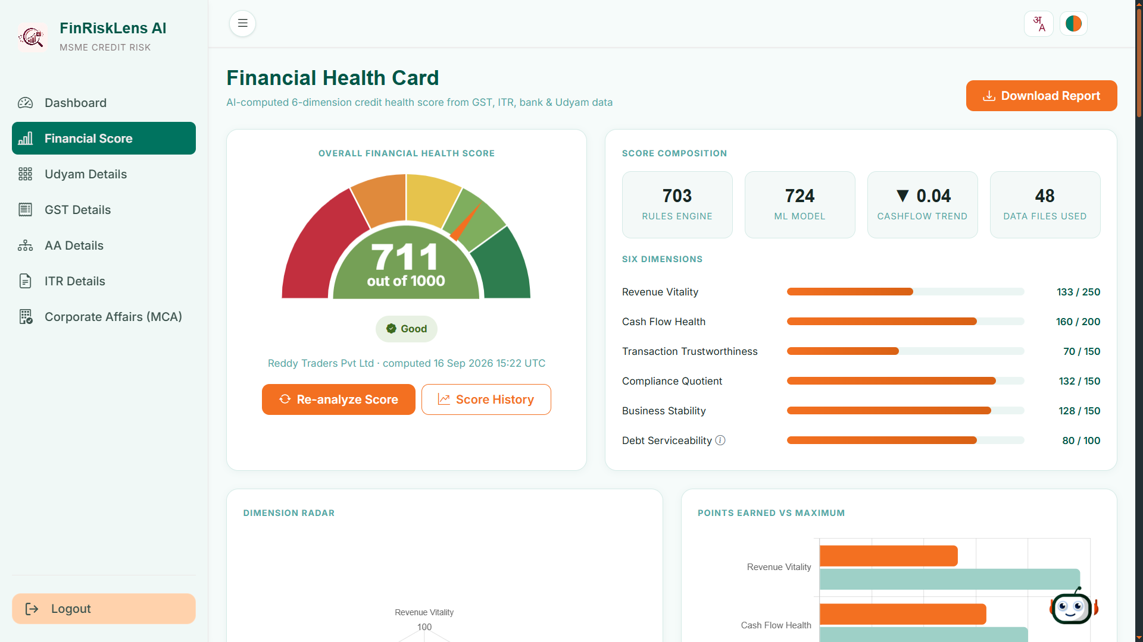
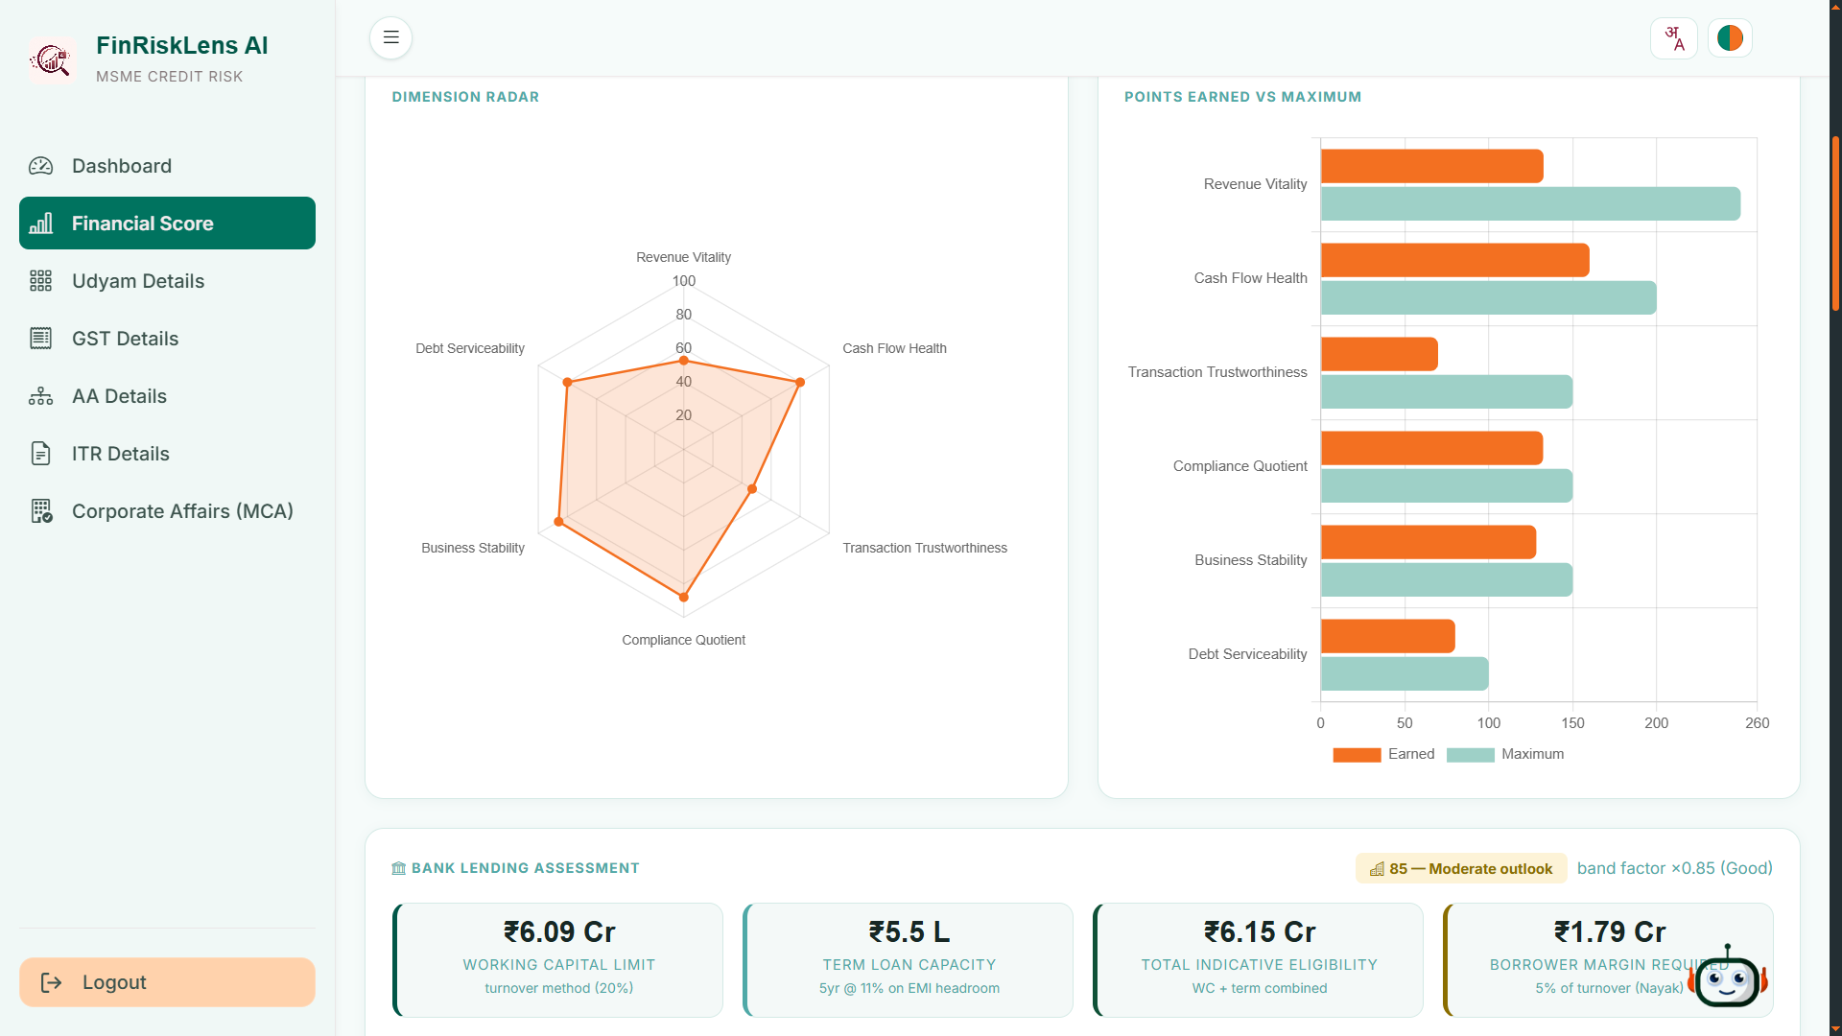
Snapshots of the prototype

Slide 15
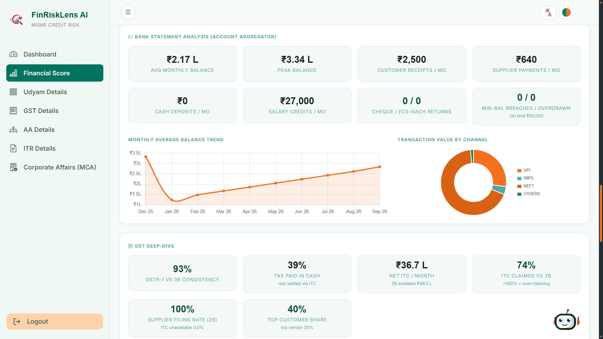
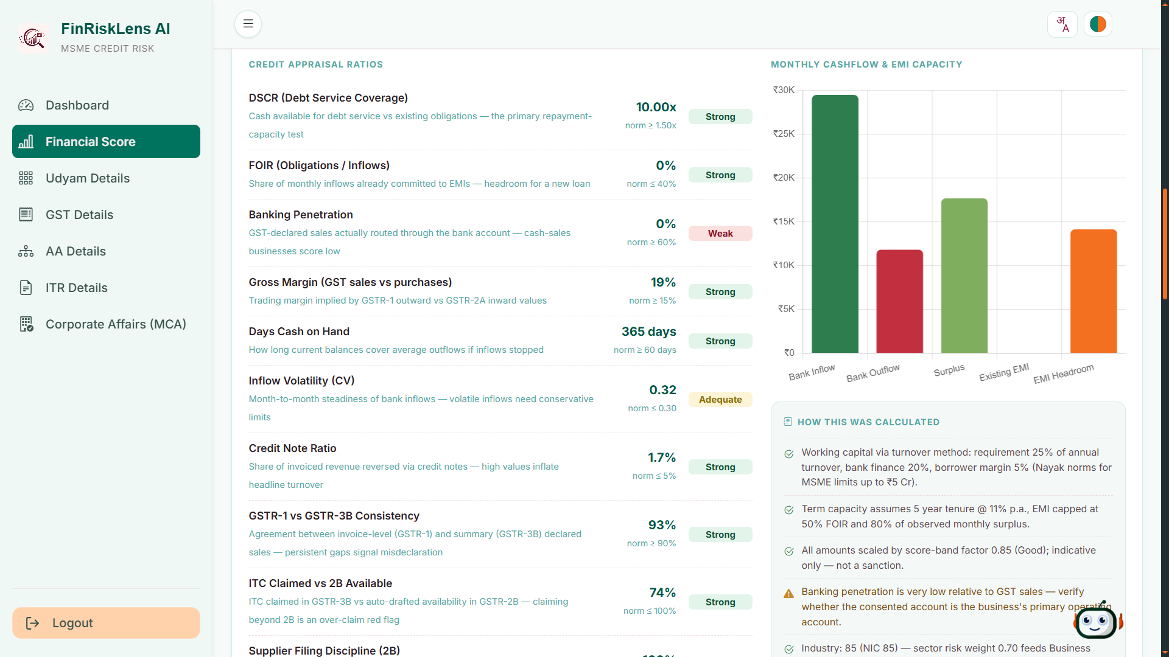
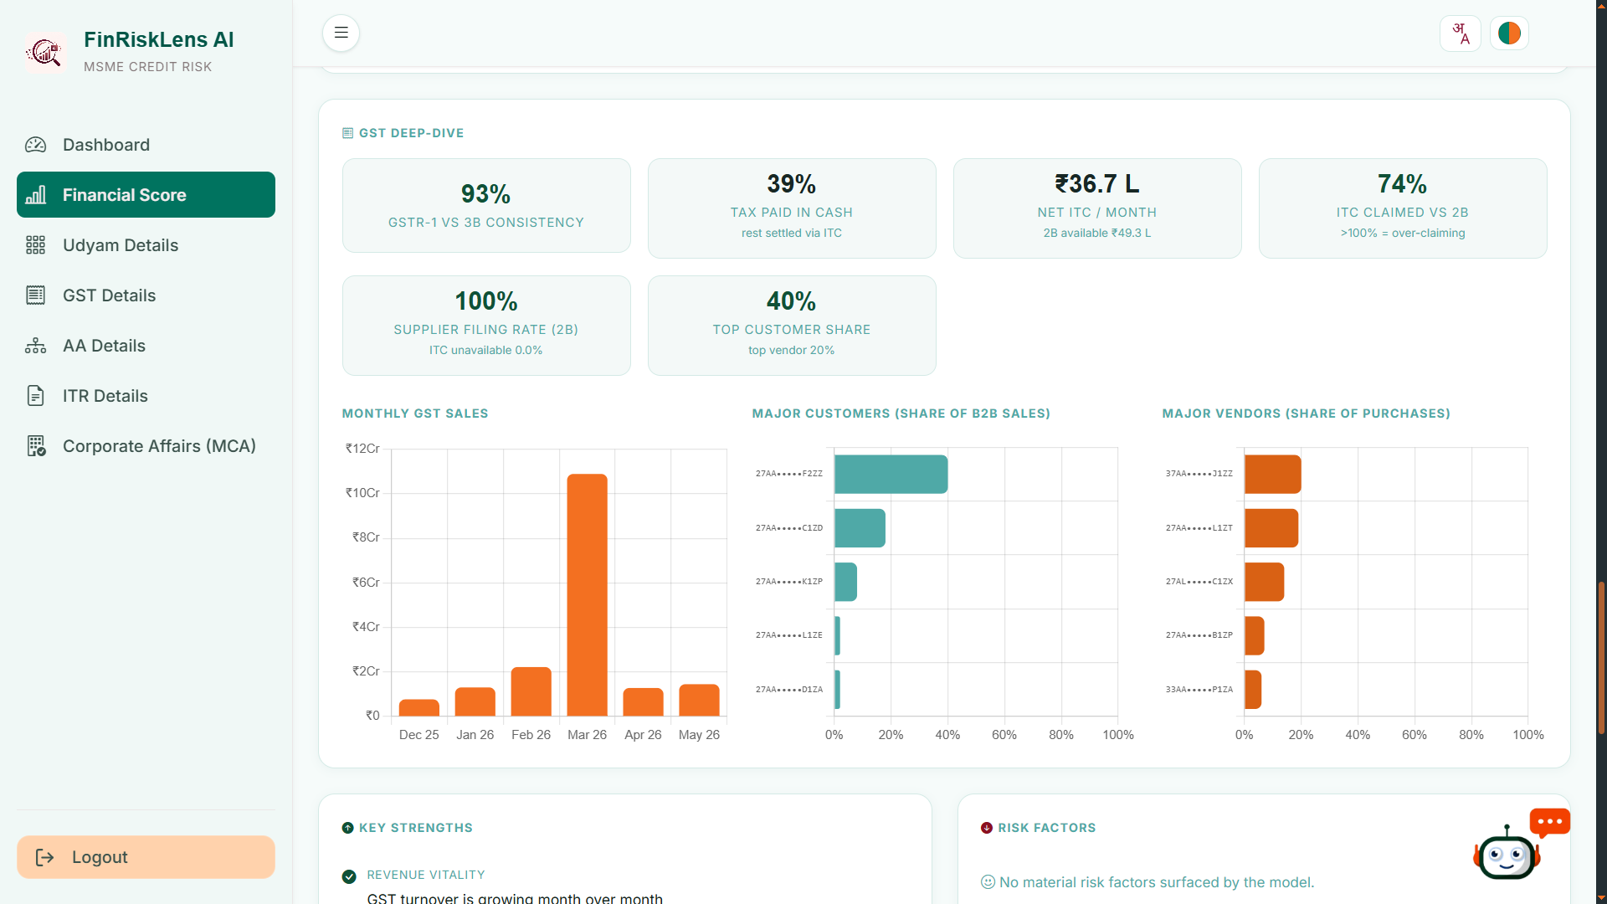
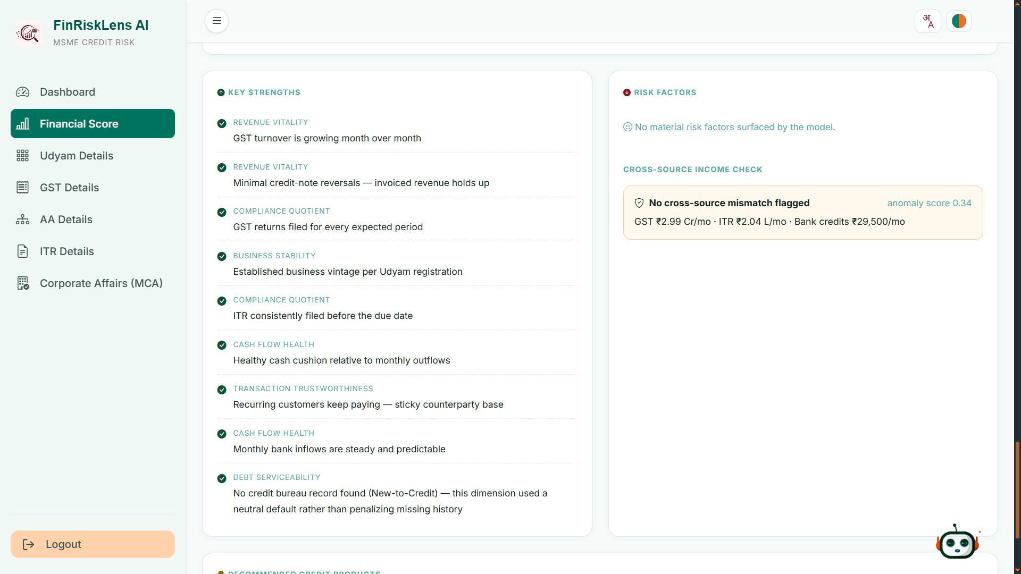
Snapshots of the prototype

Slide 16
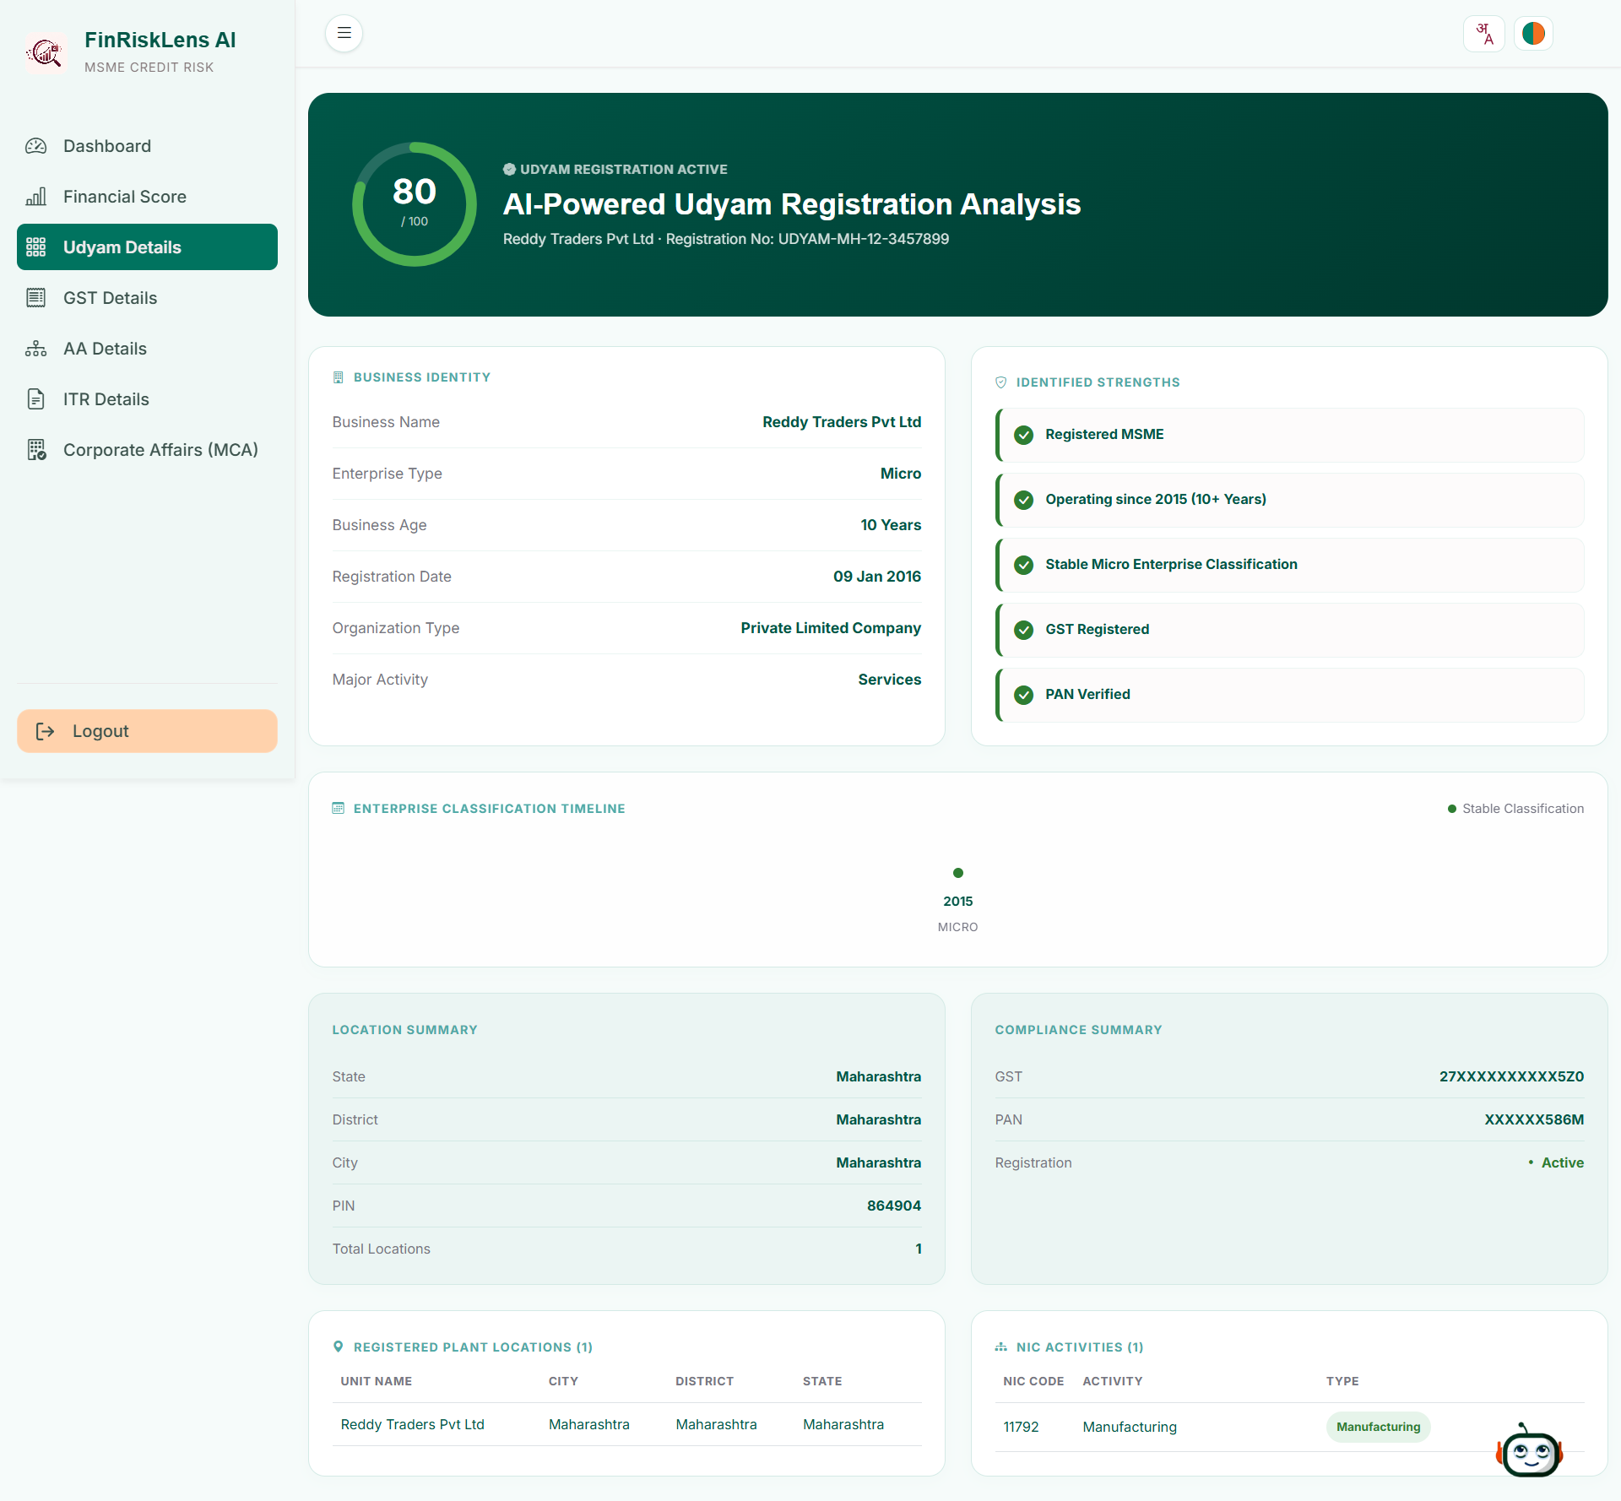
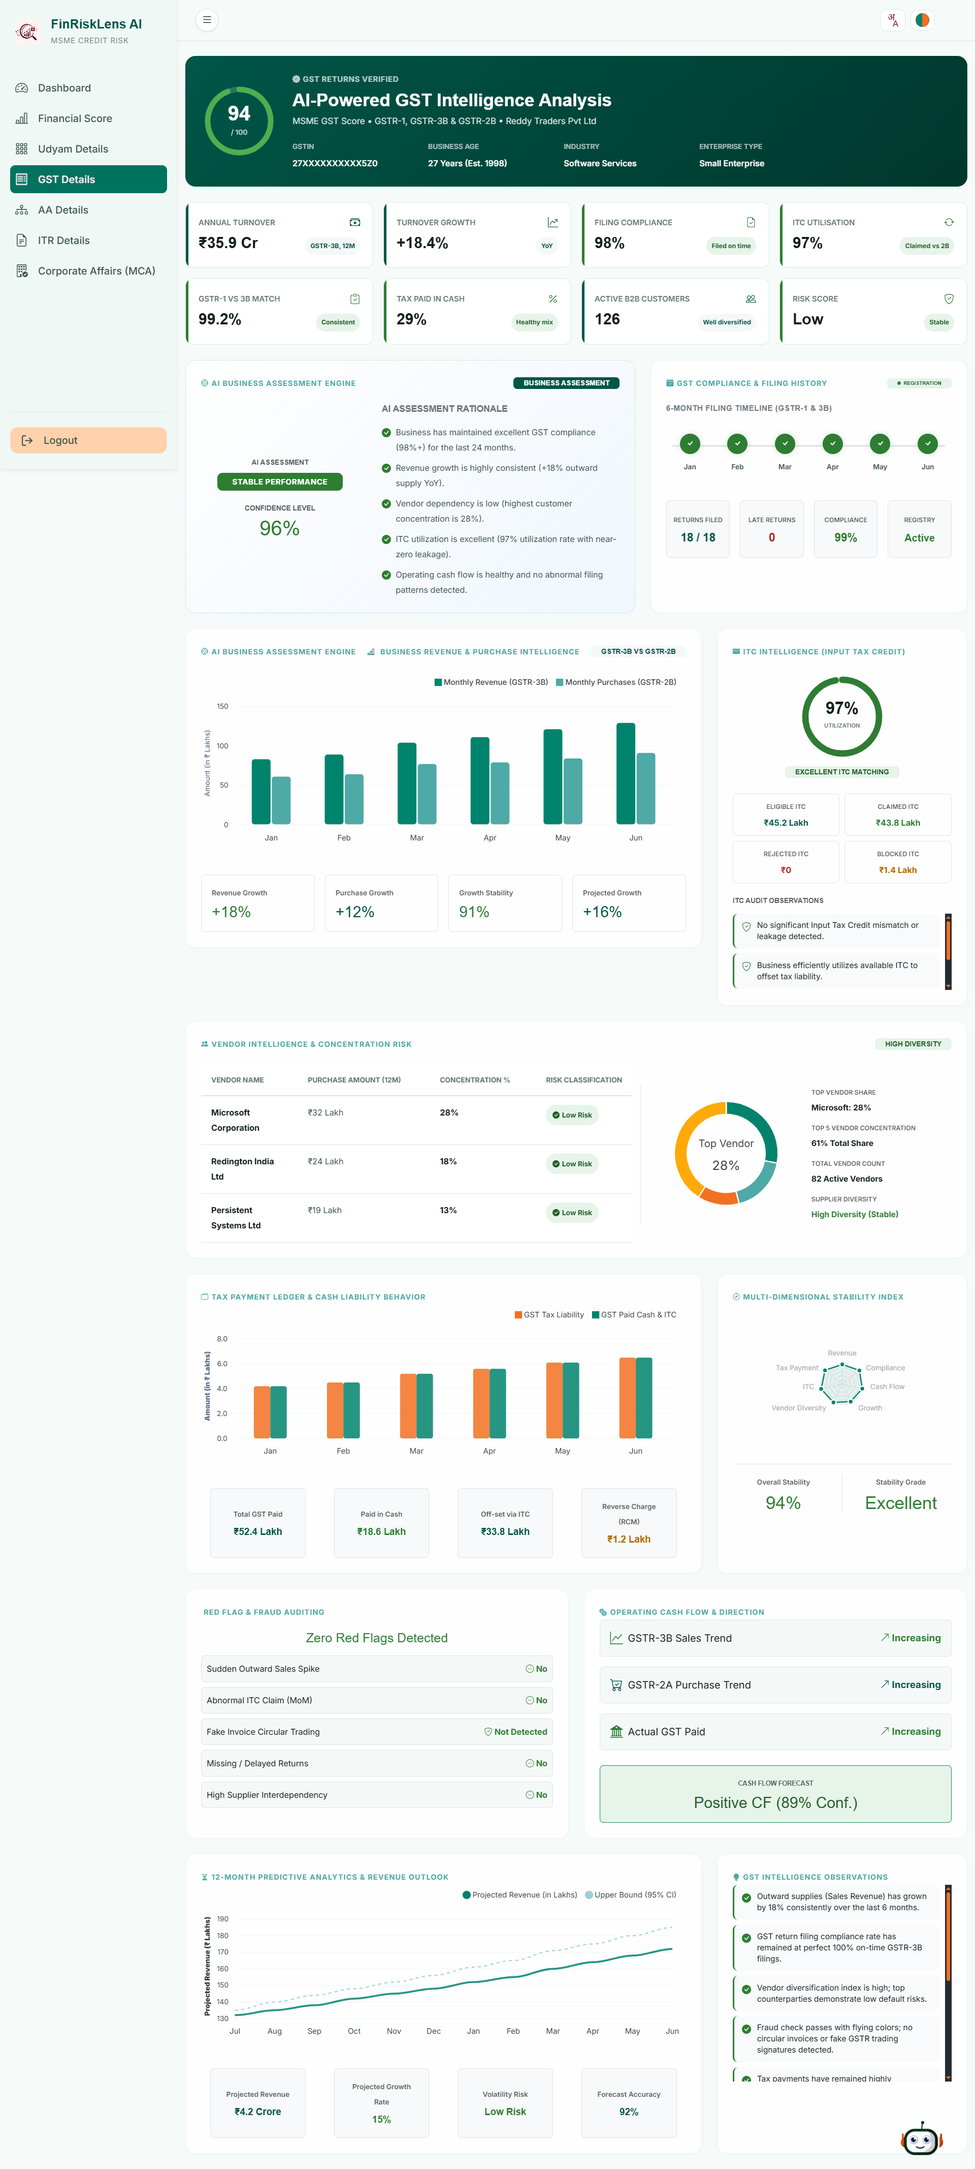
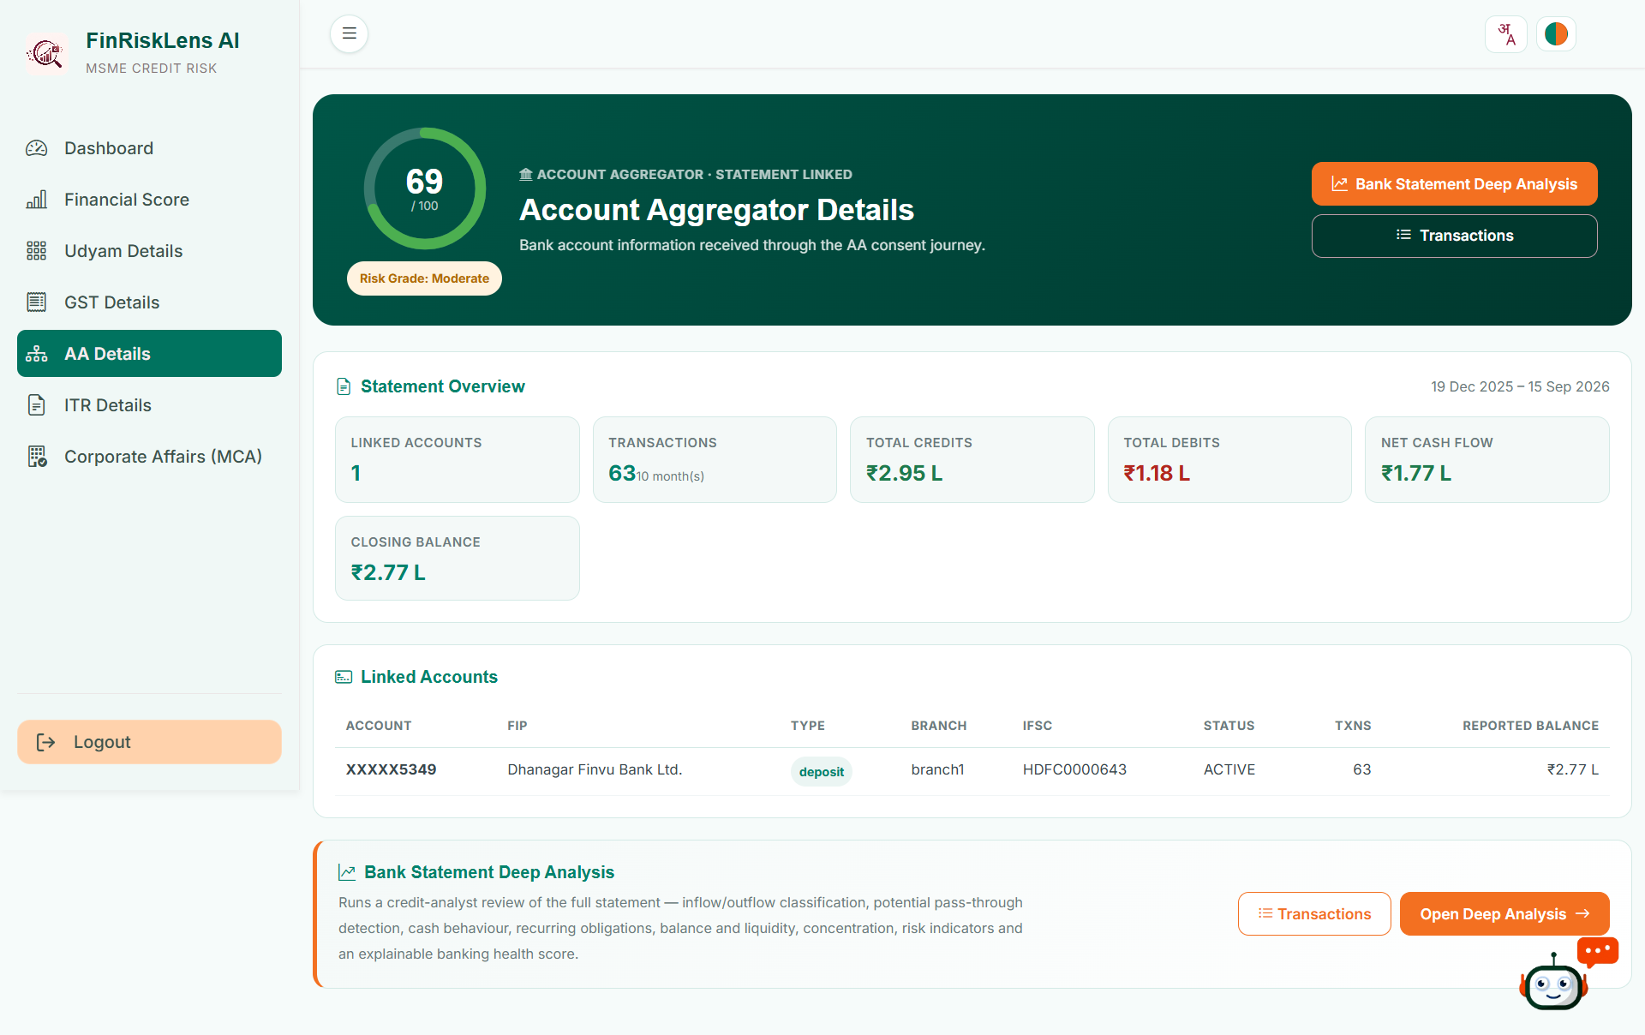
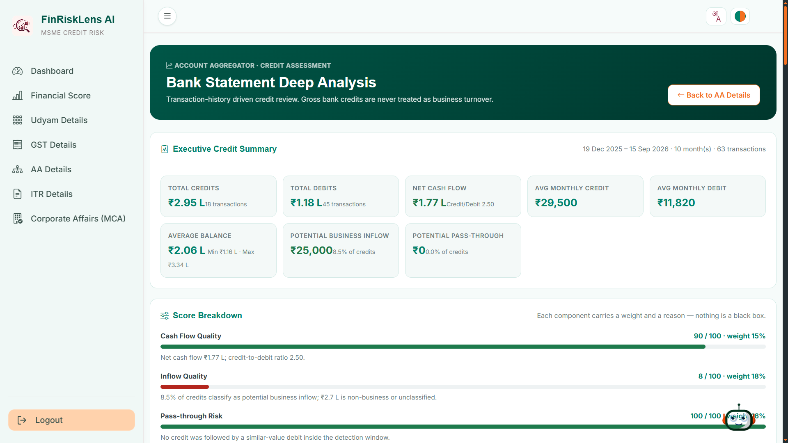
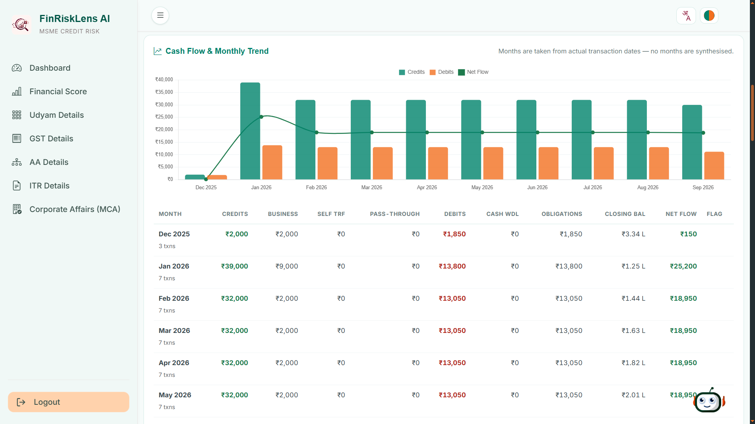
Snapshots of the prototype

Slide 17
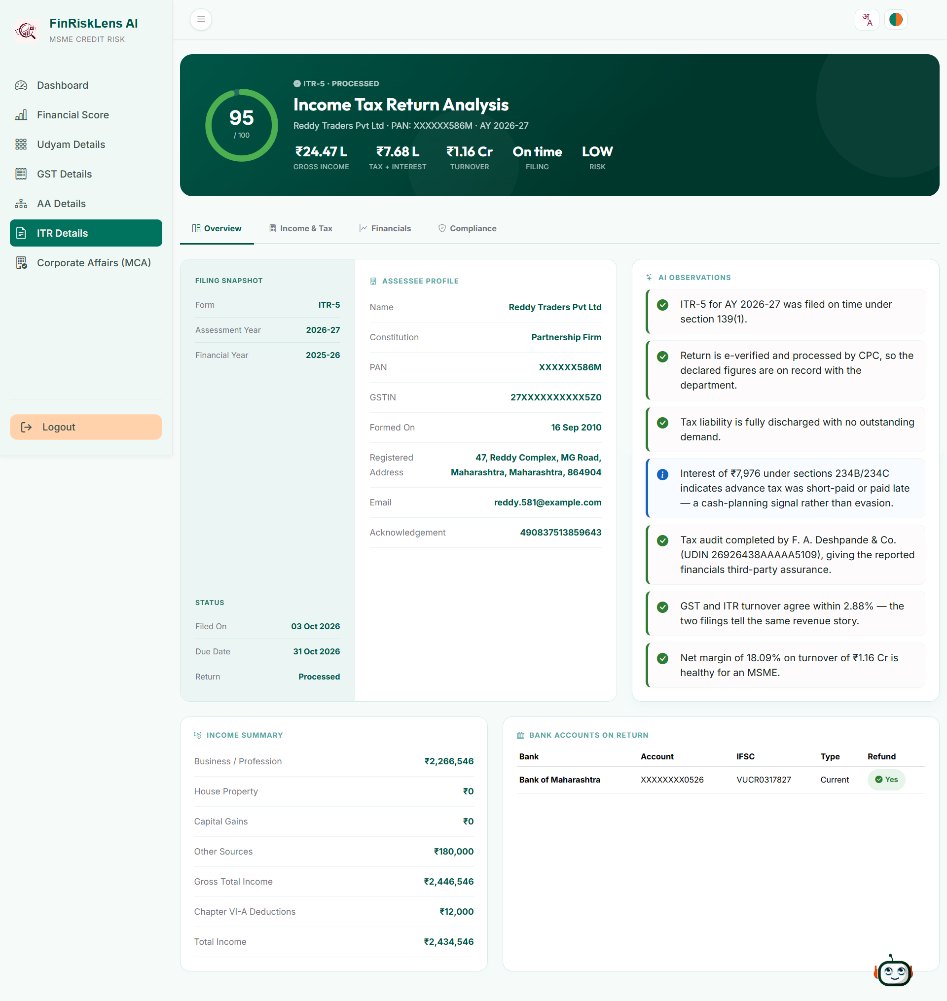
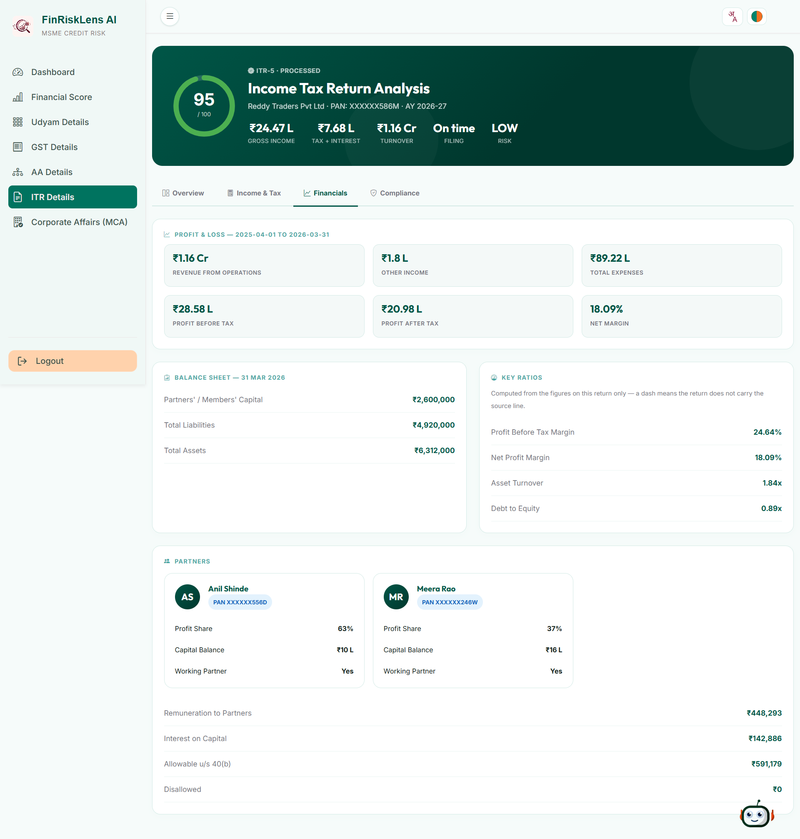
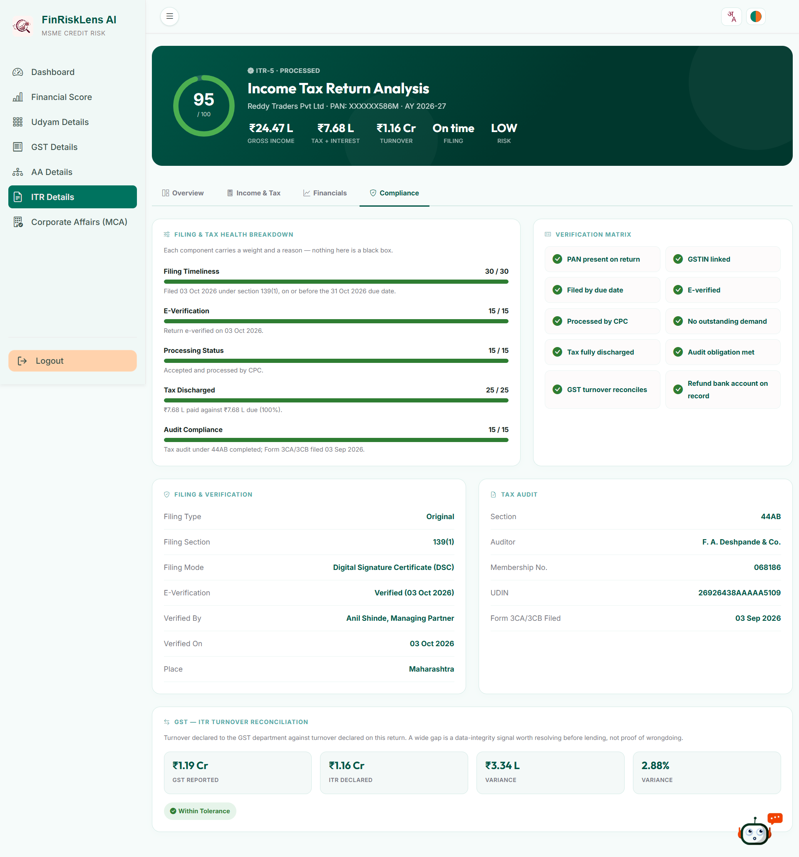
Snapshots of the prototype

Slide 18
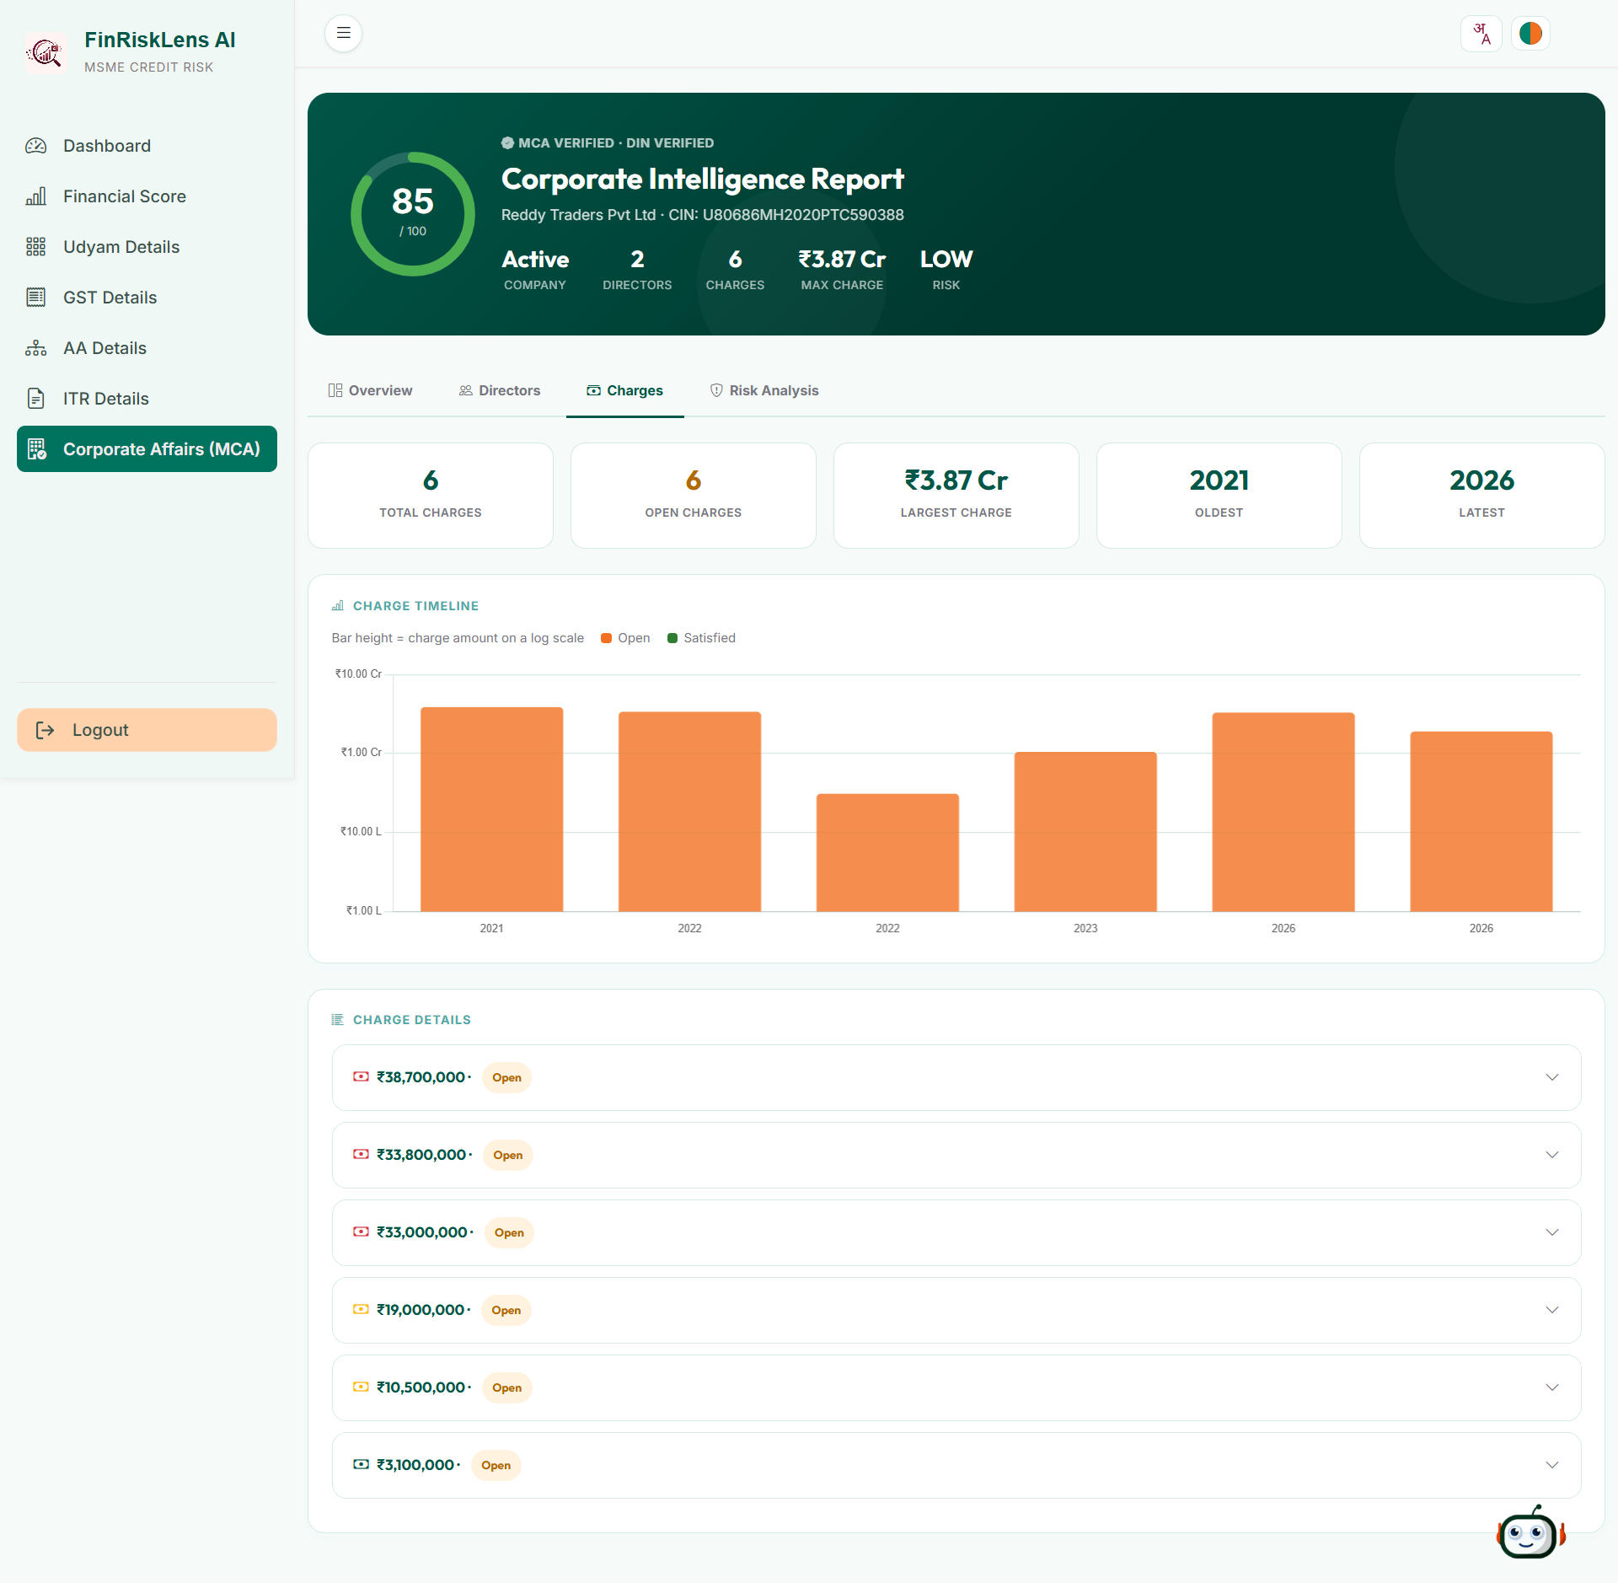
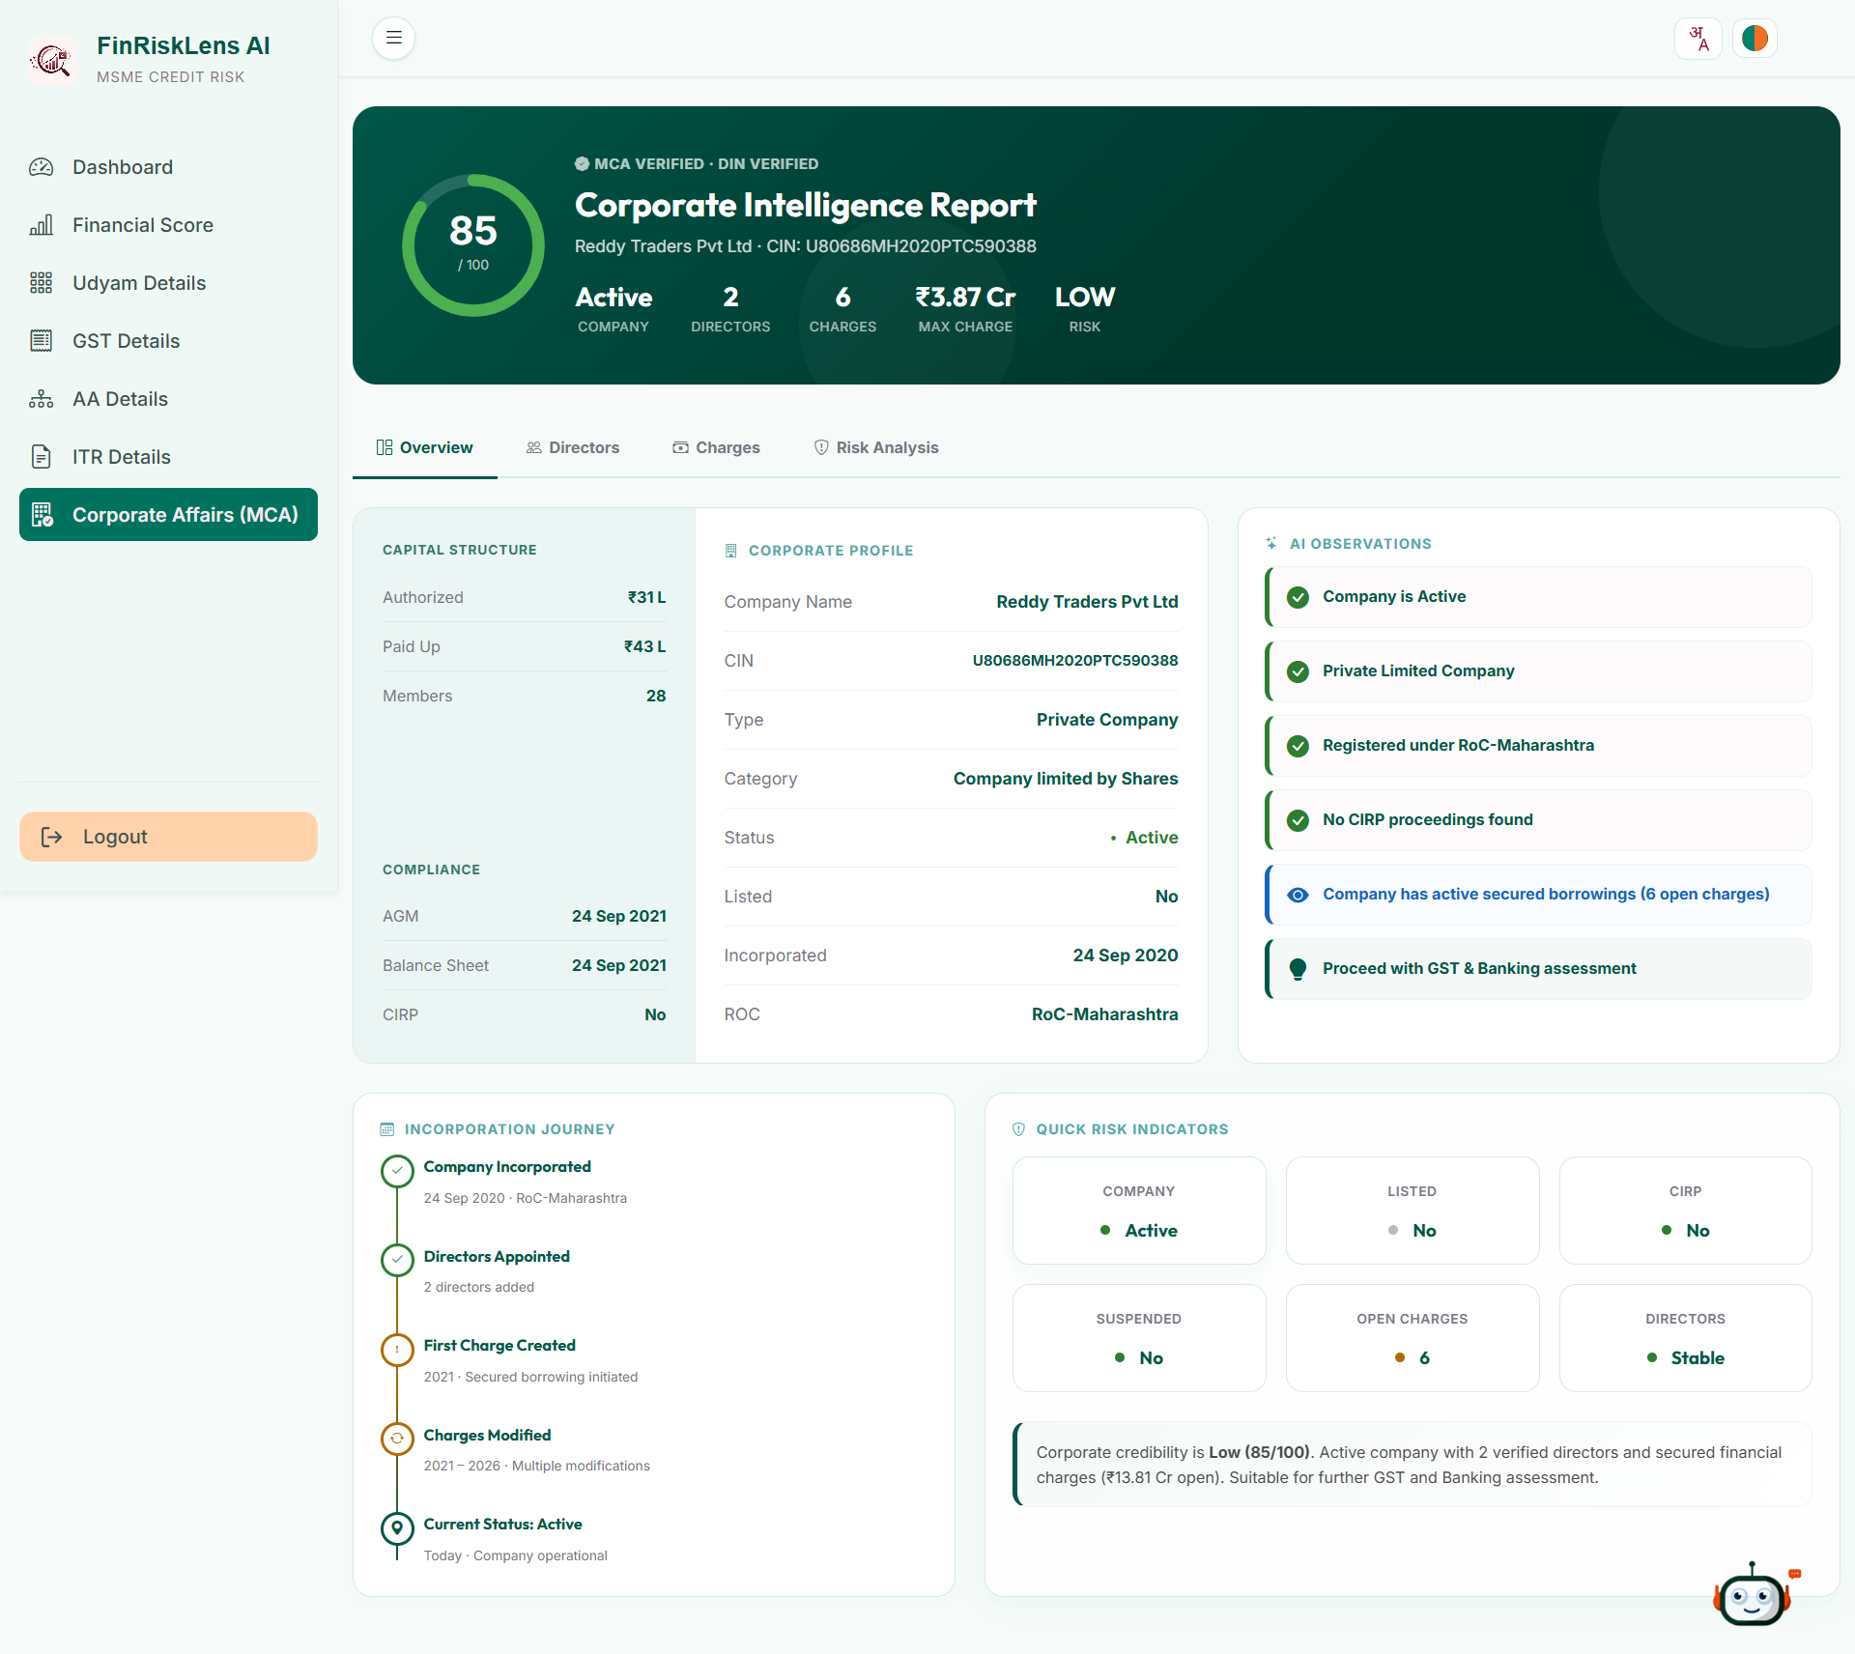
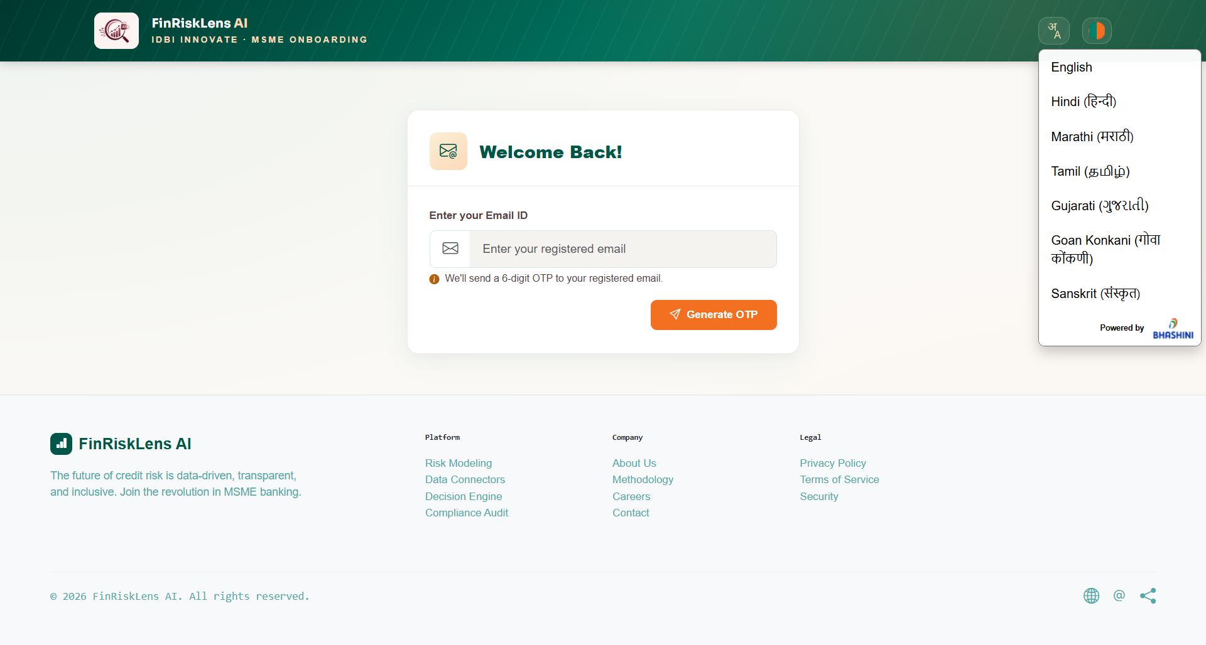
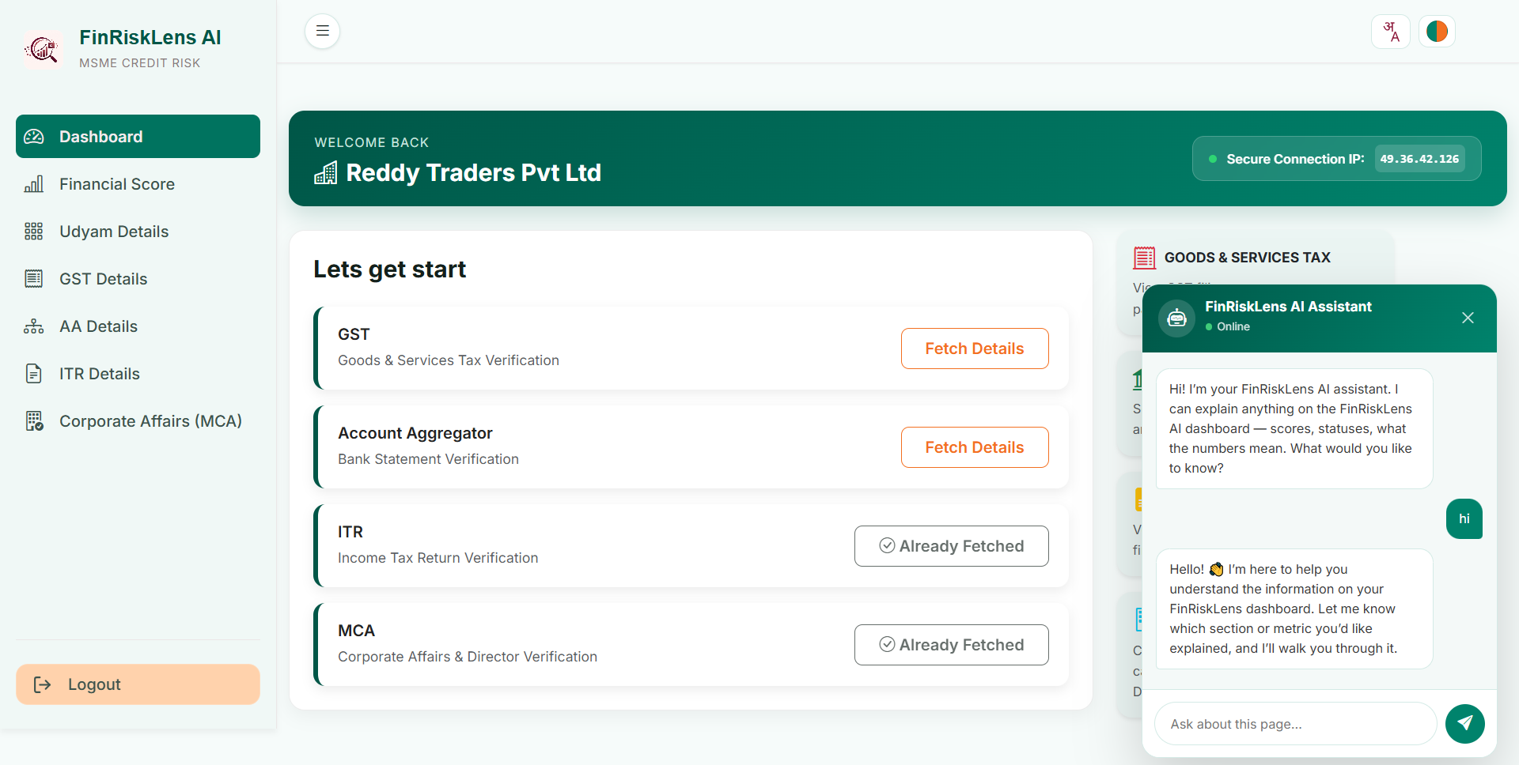
Snapshots of the prototype

Slide 19
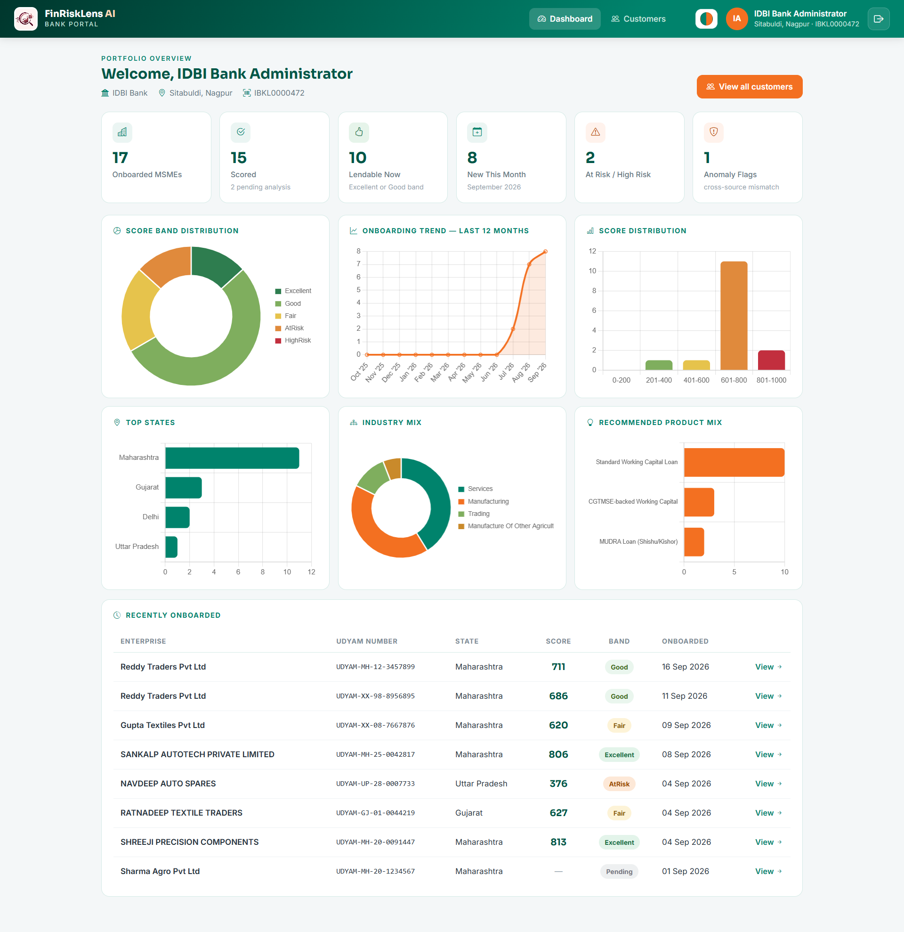
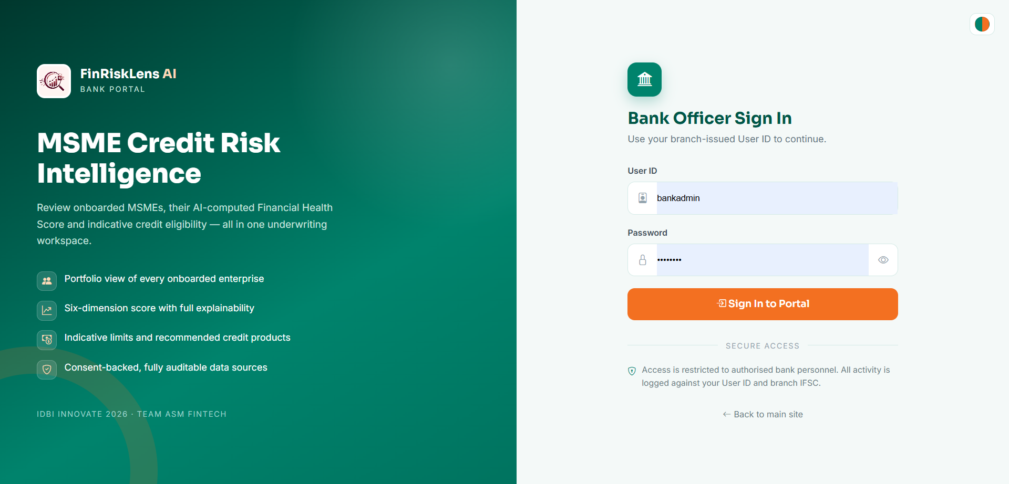
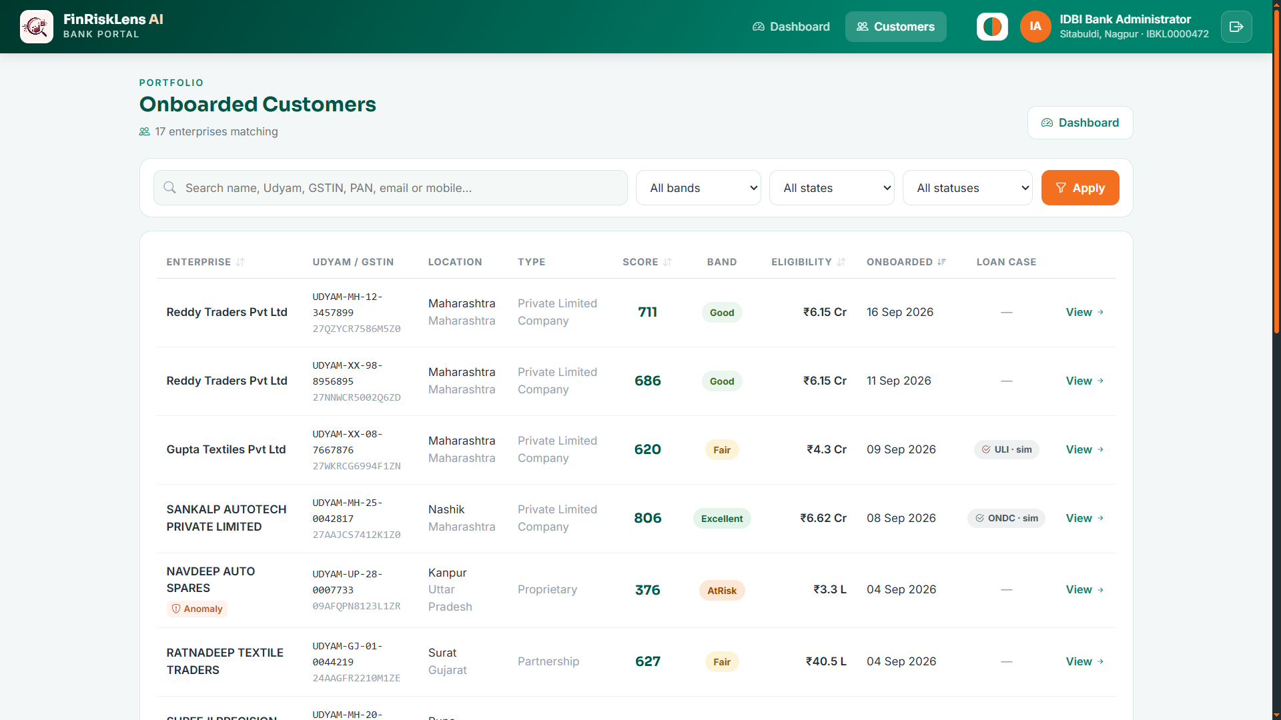
Snapshots of the prototype

Slide 20
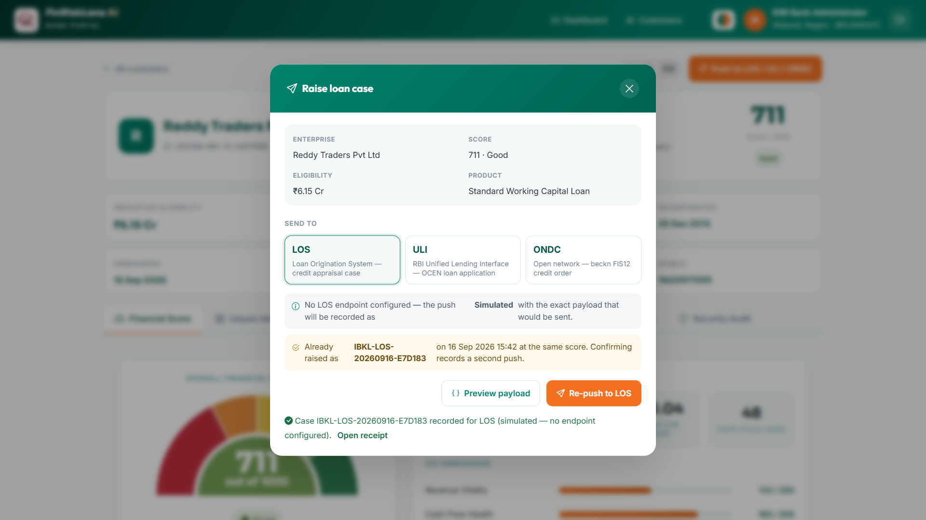
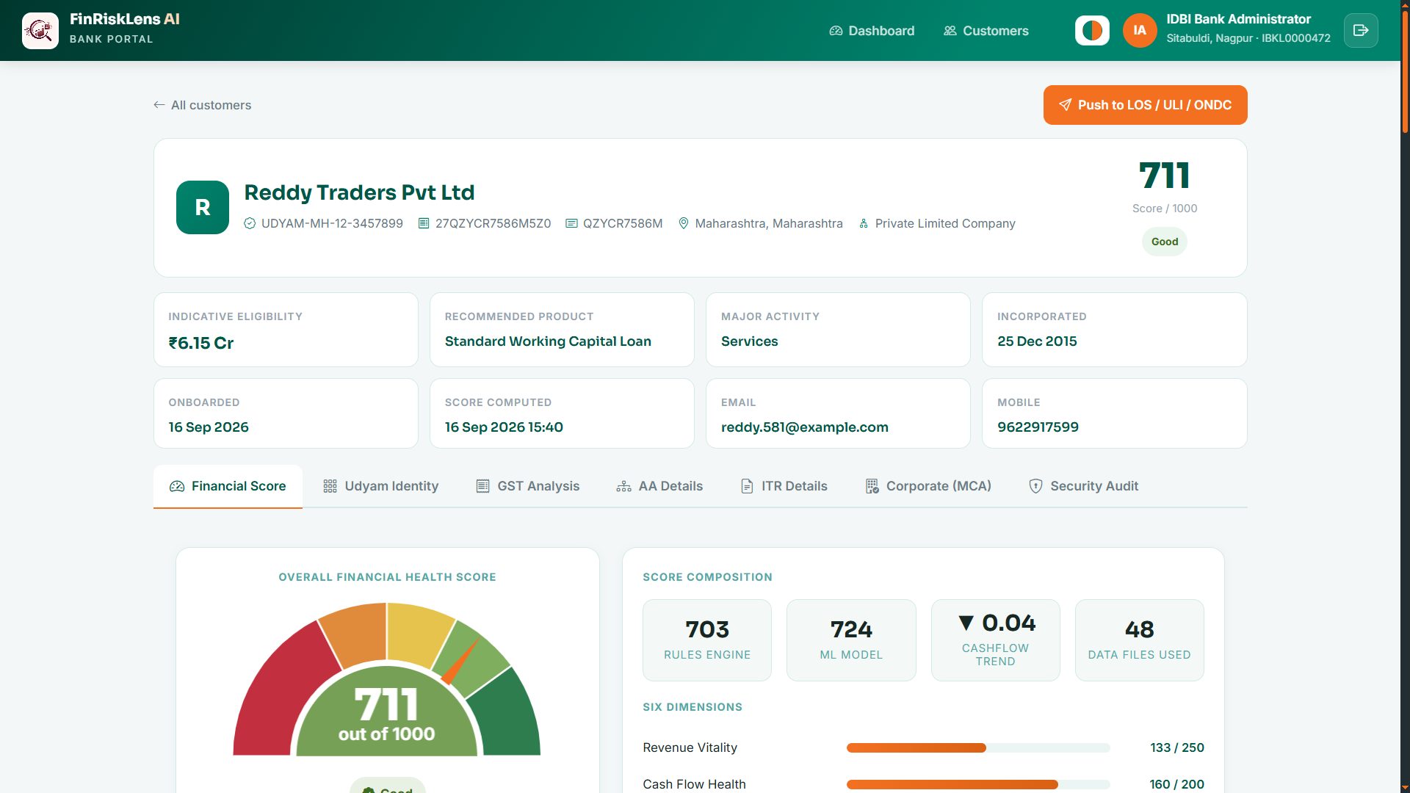
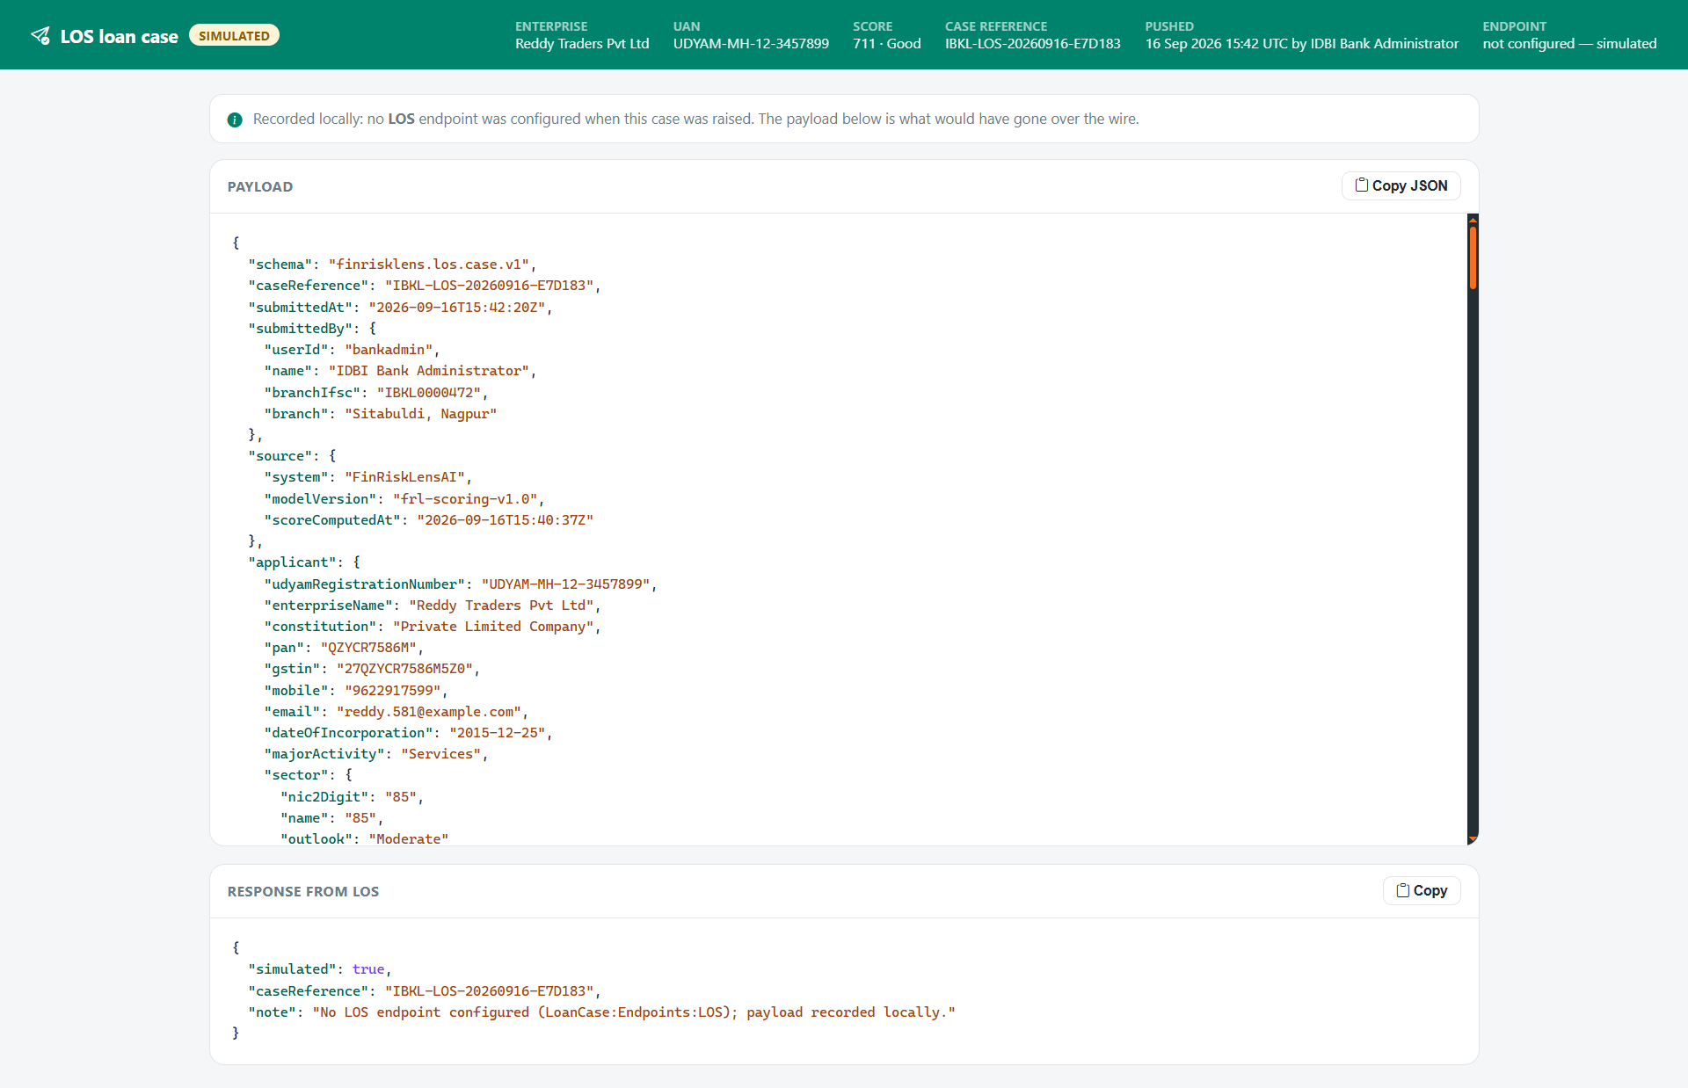
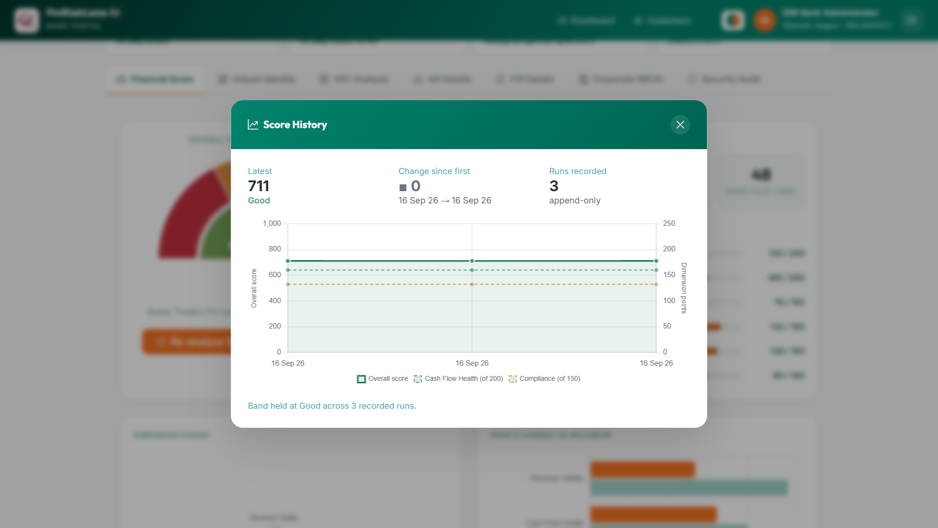
Snapshots of the prototype

Slide 21
Prototype Performance report/Benchmarking
715/1000
Live score on a real MSME — 12 months of GST + bank data (band: Good)
< 10 s
End-to-end scoring (sub-second when warm)
5
Data sources fused: Udyam · GST · ITR · AA · MCA (+ EPFO ready)
3000
MSME profiles the LightGBM model trains on
Benchmark vs. traditional credit assessment
Metric | Traditional / bureau | FinRiskLensAI
Turnaround time | 2-3 weeks (manual) | Seconds (automated)
NTC / NTB borrowers | Rejected - no history | Scored on alternate data
Data sources | 1 - bureau file | 5 - Udyam, GST, ITR, AA, MCA (+ EPFO ready)
Explainability | Black-box score | PFI reason per dimension
Fraud / integrity check | None | GST-ITR-bank anomaly + MCA / DIN checks
Monitoring | One-time assessment | Score history + trend on every analysis
Hand-off to the lender | Manual file / PDF | LOS, ULI/OCEN or ONDC payload in one action

Slide 22
Additional Details/Future Development (if any)
Next Data Integrations
• EPFO — employee count & PF-remittance regularity (the feature slot is already built)
• GST e-invoice / e-way bill signals and CERSAI collateral lookup
• ONDC / GeM / UPI merchant-settlement data for micro-enterprises
Monitoring, Fraud & Compliance
• Early Warning System on score history — band drop, GST filing lapse, new MCA charge, bounce spike
• Sanctions / PEP screening, RBI fraud registry & wilful-defaulter match
• DPDP consent ledger across all sources with customer-side revoke & auto-purge
Lending Ecosystem & Integration
• Inbound API — JWT + OpenAPI so your LOS pulls a score from us (the outbound case push is already built)
• ULI DSP + OCEN certification and a live ONDC subscriber ID; CIBIL / CRIF bureau blend for NTB borrowers
• GST-invoice financing and co-lending workflows with NBFC partners
Decision & Governance
• Credit-policy console — Approve / Refer / Decline with editable product-wise cut-offs & knock-outs
• PDF Credit Appraisal Memo with data-provenance appendix (source, time, consent ID)
• Model card & governance page (RBI model-risk); portfolio analytics for IDBI teams

Slide 23
Provide links to your:
GitHub Public Repository : https://github.com/abhinavmukwane/FinRiskLensAI
Demo Video Link (3 Minutes): https://video.finrisklensai.com OR Google Drive Link
Final Product Link: https://finrisklensai.com
Demo accounts — customer login at /Auth/CustLogin (enter email → OTP is shown on screen) · bank portal at /Auth/BankLogin,
shreeji.precision@finrisklens.demo : UDYAM-MH-20-0091447 · 813 Excellent · Shreeji Precision Components
sankalp.autotech@finrisklens.demo : UDYAM-MH-25-0042817 · 806 Excellent · Sankalp Autotech Pvt Ltd (full MCA + DIN)
ratnadeep.textiles@finrisklens.demo : UDYAM-GJ-01-0044219 · 627 Fair · Ratnadeep Textile Traders
navdeep.autospares@finrisklens.demo : UDYAM-UP-28-0007733 · 376 At Risk · Navdeep Auto Spares
This together cover the whole score range — approve, judge, and decline — with every data tab populated.
Bank Login: User ID : bankadmin | Password : Bank@123

Slide 24


